Slide 1
Introduction to Pathology
Krishna Bastola
B.Sc.MLT, M.Sc.

Slide 2
Definitions of pathology:
The word ‘pathology’ is derived from two Greek words:
Pathos meaning suffering,
Logos meaning study.
The study of the essential nature of disease, including symptoms/signs, pathogens, complications and morphological consequences including structural and functional alterations in cells, tissues and organs.
The study of the gross and microscopic patterns of disease.

Slide 3
Definitions of pathology:
Pathology is, thus, scientific study of structure and function of the body in disease; or in other words, pathology consists of the abnormalities that occur in normal anatomy (including histology) and physiology owing to disease.
Pathophysiology:
Patho- suffering
Physiology- study of normal function.
Pathophysiology, thus, includes study of disordered function or breakdown of homeostasis in diseases.
Pathologists/Laboratory Scientists are the diagnosticians of disease.

Slide 4
Terminology in pathology
Patient is the person affected by disease.
Disease is a condition in which the presence of an abnormality of the body causes a loss of normal health.
Idiopathic – no identifiable causes.
Iatrogenic – occur as a result from medical treatment.
Congenital – disease existing at birth or before birth, involves in the development of fetus.
Acquired – develops post–fetally.
Nosocomial – due to being in a hospital environments.
Lesions are the characteristics changes in tissues and cells produced by disease in an individual or environmental animal.
Pathological changes or morphology consists of examination of diseased tissues.

Slide 5
Terminology in pathology
Pathologic changes can be recognized with the naked eye (gross or macroscopic changes) or studied by microscopic examination of tissues.
Causal factors responsible for the lesions (or disease) are included in etiology of disease (i.e. ‘why’ of disease).
Mechanisms by which the lesions are produced is termed pathogenesis of disease (i.e. ‘how’ of disease).
Functional implications of the lesions felt by the patients are symptoms (pain, nausea, vomiting, etc.) and those discovered by the clinician are the physical signs (pulse rate, blood pressure, temperature, etc.).

Slide 6
Terminology in pathology
Clinical significance of the morphologic and functional changes together with results of other investigations help to arrive at an answer to what is wrong (diagnosis), what is going to happen (prognosis), what can be done about it (treatment), and finally what should be done to avoid complications and spread (prevention) (i.e. ‘what’ of disease).
Epidemiology is the study of tracking patters of disease occurrence and transmission among populations and by geographic areas.
Epi= among
Demos= People
Logy= study
Incidence of a disease – is the number of new cases occurring in specific time of period.
Prevalence of a disease – is the number of existing cases within a populations during the specific time of period.

Slide 7
Pathology Basis of Disease (disease process)
The four aspects of a disease process that form the core of pathology are:
its cause (etiology),
the mechanisms of its development (pathogenesis),
the structural alterations induced in the cells and organs of the body (morphologic changes),
the functional consequences of the morphologic changes (clinical significance).
Etiology (cause)
a. Genetic
b. Acquired (e.g., infectious, nutritional, chemical, physical).
Pathogenesis: sequence of events in the response of cells or tissues to the etiologic agent, from the initial stimulus to the ultimate expression of the disease

Slide 8
Pathology Basis of Disease (disease process)
Morphologic changes
a. Gross changes
b. Microscopic changes
Clinical significance
a. Signs and symptoms
b. Disease course- complications
c. Prognosis

Slide 9
Methods Used in Pathology
Gross examination of organs
a. Gross examination of organs has two major components
Identifying the organ (what organ)
Identifying the pathology (what's wrong)
b. Useful gross features
Size
Shape
Consistency
Color

Slide 10
Methods Used in Pathology
2. Microscopic examination of tissue
Light microscopy
Hematoxylin and Eosin (H&E) - Gold Standard Stain
Most widely used histological stain.
Comparatively simple and has ability to demonstrate clearly an enormous number of different tissue structures.
Hematoxylin (basic dye; stains acidic components) stains the cell nuclei blue/black, with good intranuclear detail,
while the eosin (acidic dye; stains basic components) stains cell cytoplasm and most connective tissue fibres in varying shades and intensities of pink, orange and red.

Slide 11
Methods Used in Pathology
2. Microscopic examination of tissue
Light microscopy
Table: Structure stained by Hematoxylin and Eosin (H&E)
Hematoxylin | Eosin
Stains blue to purple | Stains pink to red
Neuclei | Cytoplasm
Neucleoli | Collagen
Bacteria | Fibrin
Calcium | RBCs
Many others… | Thyroid colloid
 | Many others…

Slide 12
Methods Used in Pathology
2. Microscopic examination of tissue
b. Other histochemical stains (chemical reactions)
Prussian blue – iron
Congo red – amyloid
Acid fast (Ziehl-Neelson) – acid-fast bacilli
Periodic Acid-Schiff (PAS) – with high carbohydrate content molecules
Gram’s stain – bacteria
Trichrome – cells and connective tissue
Reticulin – collagen type III molecules
c. Immunohistochemical (antibody) stains
Cytokeratin – epithelial cells
Vimentin – cells of mesenchymal origin
Desmin – smooth, cardiac and skeletal myosin
Prostate specific antigen (PSA)
Many others

Slide 13
Methods Used in Pathology
Ancillary techniques
Immunofluorescence microscopy (IFM)
Renal diseases
Autoimmune diseases
Transmission electron microscopy (EM)
Renal disease
Neoplasms
Infections
Genetic disorders
Molecular techniques
Protein electrophoresis
Southern blot, Northern blot, Western blot
Polymerase chain reaction (PCR)

Slide 14
Thank you for your kind attention..!

Slide 15
Cell injury

Slide 16
Definition of Cell
A cell is the smallest unit that is capable of performing life functions.
(Structural and functional unit of life)
Cells forms organs and systems in the human body

Slide 17
Definition of Cell injury
Cell injury is defined as a variety of stresses a cell encounters as a result of changes in its internal and external environment.
Cellular response to stress
May vary and depends upon the following variables:
The type of cell and tissue involved.
Extent and type of cell injury.

Slide 18
Cellular response to cell injury
When there is increased functional demand, the cell may adopt to the changes which are expressed morphologically and then revert back to normal after the stress is removed (cellular adaption).
When the stress is mild to moderate, the injured cell may recover (reversible cell injury), while when the injury is persistent cell death may occur (irreversible cell injury).
The residual effects to reversible cell injury may persist in the cell as evidence of cell injury at subcellular level (subcellular changes), or metabolites may accumulate within the cell (intracellular accumulations).

Slide 19
Normal cell
(homeostasis)
Stress,
Increased
demand
Injurious
stimulus
Inability to adapt
_ _ _ _ _ _ _ _ _ _ _ _ _ _ _ _ _ _ _
Cell injury
Adaption
Reversible
cell injury
Subcellular alterations
_ _ _ _ _ _ _
Point of irreversibility
Necrosis
Apoptosis
Fig: Stages in the cellular response to stress and injurious stimuli.

Slide 20
Terminologies
Atrophy: decrease in cell size and functional ability
Causes of atrophy:
Deceased workload/disuse (immobilization)
Ischemia (atherosclerosis)
Lack of hormonal or neural stimulation
Malnutrition
Aging
Hypertrophy: an increase in cell size and functional ability due to increased synthesis of intracellular components
Causes of hypertrophy:
Increased mechanical demand
Physiologic ---striated muscle of weight lifters
Pathologic ---cardiac muscle in hypertension
ii. Increased endocrine stimulation
Puberty (growth hormone, androgens/estrogens, etc.)
Gravid uterus (estrogen)
Lactating breast (prolactin and estrogen)

Slide 21
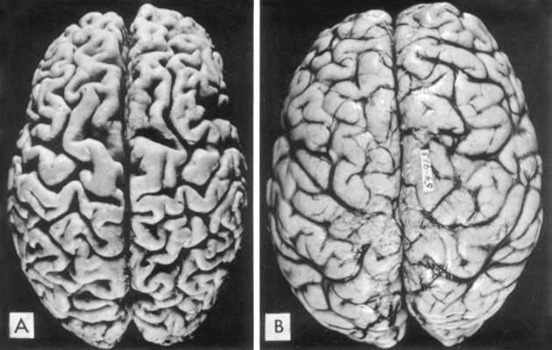
Terminologies
Fig: A, Atrophy of the brain in an 82-year-old male with atherosclerotic disease. Atrophy of the brain is due to aging and reduced blood supply.
B, Normal brain of a 36-year-old male.

Slide 22
Terminologies
Hyperplasia: an increase in the number of cells in a tissue or organ. Some cell types are unable to exhibit hyperplasia (e.g. nerve, cardiac, skeletal muscle cells)
1. Physiologic causes of hyperplasia
Compensatory (e.g., after partial hepatectomy)
Hormonal stimulation (e.g., breast development at puberty)
Antigenic stimulation (e.g. lymphoid hyperplasia)
2. Pathologic causes of hyperplasia
Endometrial hyperplasia
Prostatic hyperplasia of aging
Metaplasia: a reversible change of one cell type to another, usually in response to irritation.
It has been suggested that the replacement cell is better able to tolerate the environmental stresses. For example, bronchial columnar epithelium undergoes squamous metaplasia in response to the chronic irritation of tobacco smoke.

Slide 23
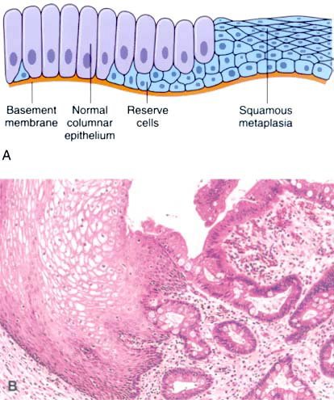
Terminologies
Fig: Metaplasia of normal columnar (left) to squamous epithelium (right), shown (A) schematically and (B) histologically.

Slide 24
Terminologies
Dysplasia: an abnormal proliferation of cells that is characterized by changes in cell size, shape, and loss of cellular organization
Dysplasia is not cancer but may progress to cancer (preneoplastic lesion)
Example: cervical dysplasia
Ischemia: deficient blood supply to part of tissue. The cessation of blood supply may be complete (complete ischemia) or partial (partial ischemia).

Slide 25
Causes of cell injury
Hypoxia
Most common cause of injury
Definition: lack of oxygen leads to the inability of the cell to synthesize sufficient ATP by aerobic oxidation
Major causes of hypoxia
i. Ischemia: loss of blood supply
Most common cause of hypoxia
Decreased arterial flow or decrease venous outflow
e.g., arteriosclerosis, thrombus
ii. Cardiopulmonary failure
iii. Decreased oxygen-carrying capacity of the blood (example: anemia)
Infections
Viruses, bacteria, parasites, and fungi (and probably prions)
Mechanism of injury
Direct infection of cells
Production of toxins
Host inflammatory response

Slide 26
Causes of cell injury
Immunologic reactions
Hypersensitivity reactions
Autoimmune diseases
Congenital disorders
Inborn errors of metabolism (i.e., inherited disorders)
Chemical injury
Drugs
Poisons (cyanide, arsenic, mercury, etc.)
Pollution
Occupational exposure (CCI4 asbestosis, carbon monoxide, etc.)
Social/lifestyle choices (alcohol, cigarette smoking, intravenous drug abuse [IVDA], etc.)

Slide 27
Causes of cell injury
Physical forms of injury
Trauma (blunt/penetrating/crush injuries, gunshot wounds, etc.)
Burns
Frostbite
Radiation
Pressure changes
Nutritional or vitamin imbalance
Inadequate calorie/protein intake
Marasmus and kwashiorkor
Anorexia nervosa
Excess caloric intake
Obesity
Atherosclerosis
Vitamin deficiency
Vitamin A – night blindness, squamous metaplasia, immune deficiency
Vitamin C – scurvy

Slide 28
Causes of cell injury
Vitamin D – rickets and osteomalacia
Vitamin K – bleeding diathesis
Vitamin B12 – megaloblastic anemia, neuropathy and spinal cord degeneration
Folate – megaloblastic anemia and neural tube defects
Niacin – pellagra (diarrhea, dermatitis, dementia and death)
d. Hypervitaminosis
Notes:
Dementia: degeneration of nerve tissue, anxiety, irratibility, poor memory, insomnia (sleeplessness)

Slide 29
Cellular changes during injury
General
Reversible cell injury
Irreversible cell injury
General
Cellular responses to injury
Adaptation
Reversible injury
Irreversible injury and cell death (necrosis/apoptosis)

Slide 30
Cellular changes during injury
b. Cellular response to injury depends on several important factors
The type of injury
The duration of injury
The severity and intensity of injury
The type of cell injured
The cell's metabolic state
The cell's ability to adapt
The critical intracellular systems that are susceptible to injury
DNA
Production of ATP via aerobic respiration
Cell membranes
Protein synthesis

Slide 31
Cellular changes during injury
Important mechanisms of cell injury
Damage to DNA, proteins, lipid membranes, and circulating lipids (LDL) caused by oxygen-derived free radicals
Superoxide anion (O2⁻)
Hydroxyl radical (OH⁻)
Hydrogen peroxide (H2O2)
ATP depletion
Increased cell membrane permeability
Influx of calcium
Second messenger
Activates a wide spectrum of enzymes
Proteases – protein breakdown

Slide 32
Cellular changes during injury
ATPases – contributes of ATP depletion
Phospholipases – cell membrane injury
Endonucleases – DNA damage
Mitochondrial dysfunction
Decreased oxidative phosphorylation and ATP production
Formation of mitochondrial permeability transition (MPT) channels
Release of cytochrome c is a trigger for apoptosis

Slide 33
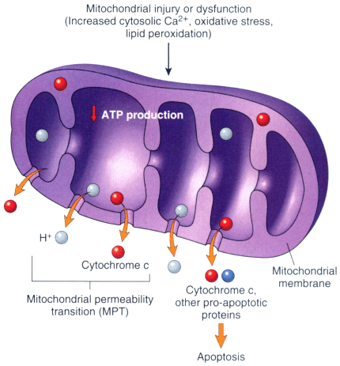
Cellular changes during injury
Fig: Mitochondrial dysfunction in cell injury.

Slide 34
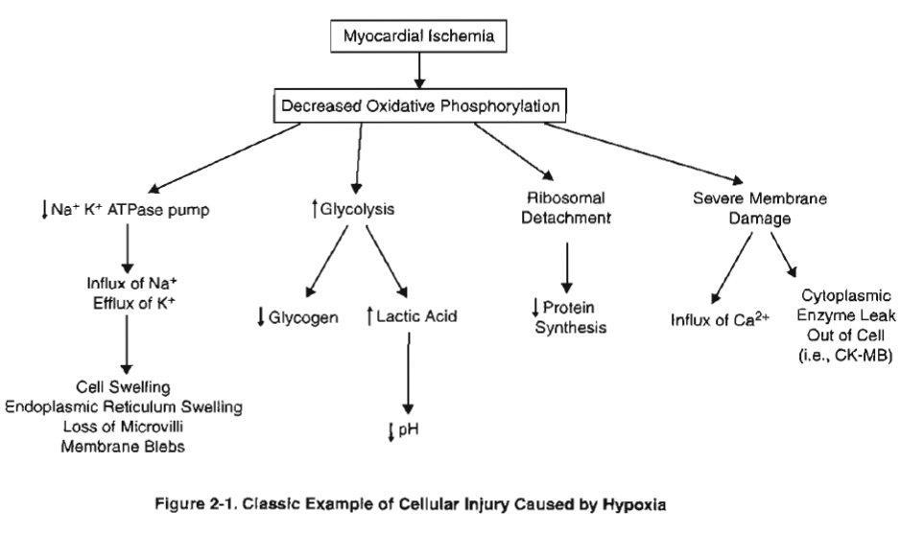
Fig: Classical example of cellular injury caused by hypoxia.
Notes:
Fig: Classical example of cellular injury caused by hypoxia.

Slide 35
Cellular changes during injury
Reversible cell injury
Decreased synthesis of ATP by oxidative phosphorylation
Decreased function of Na⁺K⁺ ATPase membrane pumps
Influx of Na⁺ and water
Efflux of K⁺
Cellular swelling (hydropic swelling)
Swelling of the endoplasmic reticulum
Switch to glycolysis
Depletion of cytoplasmic glycogen
Increased lactic acid production
Decreased intracellular pH
Decreased protein synthesis
Detachment of ribosomes from the rough endoplasmic reticulum
Plasma-membrane blebs and myelin figures may be seen

Slide 36
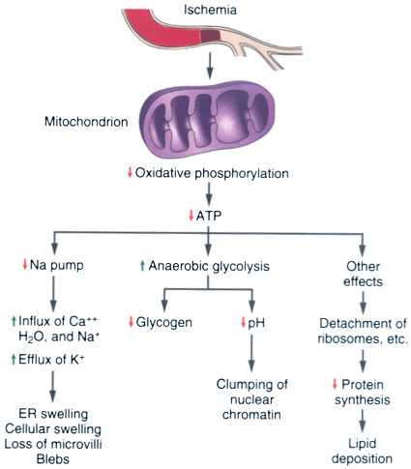
Figure: Mitochondrial dysfunction in cell injury.

Slide 37
Cellular changes during injury
Irreversible cell injury
Severe membrane damage
Membrane damage plays a critical role in irreversible injury
Massive influx of calcium
Efflux of intracellular enzymes and proteins into the circulation
Marked mitochondrial dysfunction
Mitochondrial swelling
Large densities are seen within the mitochondrial matrix
Irreparable damage of the oxidative phosphorylation pathway
Inability to produce ATP

Slide 38
Cellular changes during injury
Irreversible cell injury
Rupture of the lysosomes
Release of lysosomal digestive enzymes into the cytosol
Activation of acid hydrolases followed by autolysis
Nuclear changes
Pyknosis: degeneration and condensation of nuclear chromatin
Karyorrhexis: nuclear fragmentation
Karyolysis: dissolution of the nucleus

Slide 39
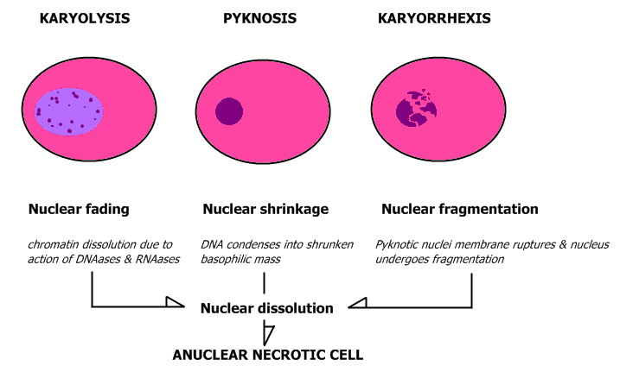
Cellular changes during injury

Slide 40
Features of Necrosis and Apoptosis
Features | Necrosis | Apoptosis
Definition | Cell death along with degradation of tissue by hydrolytic enzymes | Programmed and coordinated cell death
Causative agents | Hypoxia, toxins | Physiological and pathological process
Cell size | Enlarged (swelling) | Reduced (shrinkage)
Nucleus | Pyknosis – karyorrhexis – karyolysis | Fragmentation into nucleosome-size fragments
Plasma membrane | Disrupted | Intact; altered structure, especially orientation of lipids
Cellular contents | Enzymatic digestion; may leak out of cell | Intact; may be released in apoptotic bodies
Adjacent inflammation | Frequent | No
Physiologic or pathologic role | Invariably pathologic (culmination of irreversible cell injury) | Often physiologic, means of eliminating unwanted cells; may be pathologic after some forms of cell injury, especially DNA damage

Slide 41
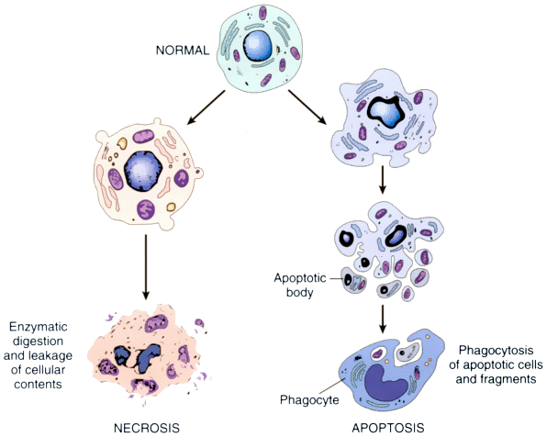
Features of Necrosis and Apoptosis
Figure : The sequential ultrastructural changes seen in necrosis (left) and apoptosis (right)

Slide 42
Thank you for your kind attention..!

Slide 43
Inflammation

Slide 44
Introduction
Inflammation is a protective response intended to eliminate the initial cause of cell injury as well as necrotic cells and tissues resulting from original insult.
It is defined as the reaction of vascularized connective tissue to sub-lethal injury. It is fundamentally a protective response to get rid of offensive injury.
Exogenous and endogenous stimuli that cause cell injury can provoke a complex reaction in vascularized connective tissue which is known as inflammation.
In human, inflammation is characterized by reaction of blood vessels leading to accumulation of fluid and leukocytes in extravascular tissue.

Slide 45
Introduction
Inflammation helps to destroy, dilute or neutralizing harmful agents (e.g., microbes and toxins) but in turn sets into motion a series of events that heal and reconstitute the damaged tissue.
Hence, without inflammation, infections would go unchecked, wounds would never heal and injured organs might remain as permanent stress/ulcers.
Inflammatory reaction may be potentially harmful as for e.g., during life threatening hypersensitivity by insect bites, drugs and toxins or rheumatoid arthritis, arthrosclerosis and lung fibrosis.
Hence, anti-inflammatory drugs are used to control the harmful effects of inflammation.

Slide 46
Causing agents of inflammation
Infective agents like bacteria, viruses and their toxins, fungi, parasites.
Immunological agents like cell-mediated and antigen-antibody reactions.
Physical agents like heat, cold, radiation, mechanical trauma.
Chemical agents like organic and inorganic poisons.
Inert materials such as foreign bodies.

Slide 47
Cardinal features of inflammation
Rubor (redness)
Tumor (swelling)
Calor (heat)
Dolor (pain)
Functio laesa (loss of function)

Slide 48
Types of inflammation
Depending upon the defense capacity of the host and duration of response, inflammation can be classified a acute and chronic.
Acute inflammation
It is a rapid response to injury or microbes and other foreign substances that is designed to deliver leukocytes and plasma proteins to sites of injury.
It is short duration (lasting less than 2 weeks) and represents the early body reaction, resolves quickly and usually followed by healing.
Main features:
Accumulation of fluid and plasma at the affected site
Intravascular activation of platelets
Polymorphonuclear neutrophils as inflammatory cells

Slide 49
Acute inflammation
Two major components:
Vascular changes: increased blood flow (vasodilation) and permit plasma proteins to leave the circulation (increased vascular permeability).
Cellular events: emigration of the leukocytes from the microcirculation and accumulation in the focus of injury (cellular recruitment and activation). Principle leukocytes are neutrophils (polymorphonuclear leukocytes).

Slide 50
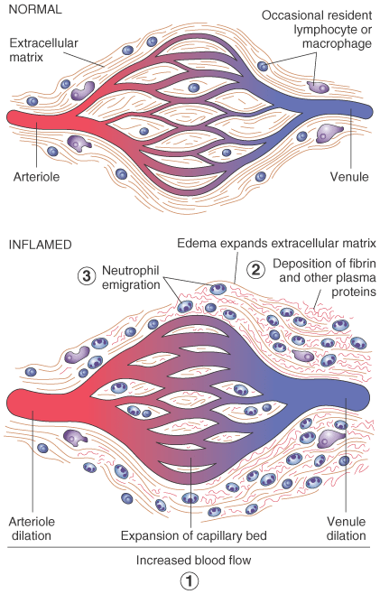
Acute inflammation
Vascular dilation and increased blood flow (causing erythema and warmth).
Extravasation and deposition of plasma fluid and proteins (edema).
Leukocytes (mainly neutrophils) emigrates and accumulation at the site of injury.

Slide 51
Acute inflammation
Exudation:
Escape of fluid, proteins and blood cells from the vascular system into interstitial tissue and body cavities.
An exudate is a fluid which has high protein concentration, cellular debris and specific gravity >1.020.
A transudate is a fluid with low protein concentration and specific gravity <1.020.
Edema: It denotes an excess of fluid in the interstitial or serous cavities which can be an exudates or transudates.
Pus: It is an exudate rich in neutrophils and cell debris.

Slide 52
Acute inflammation
Stimuli for acute inflammation:
Infections (bacterial, viral, fungal and parasitic)
Trauma and physical and chemical agents (e.g., penetration, radiation, burns, frostbite)
Tissue necrosis (e.g., MI)
Foreign bodies (e.g., dirt, sutures)
Immune reactions (e.g., reaction to bee sting)

Slide 53
Acute inflammation
Hemodynamic changes
Initial transient vasoconstriction
Massive vasodilation mediated by histamine, bradykinin and prostaglandins.
Increased vascular permeability
Chemical mediators of increased permeability
Vasoactive amines, histamine and serotonin
Bradykinin, an end-product of kinin cascade
Leukotrienes
Mechanism of increased vascular permeability
Endothelial and pericyte contraction
Direct endothelial cell injury
Leukocyte of cell injury
Blood flows slows (stasis) due to increased viscosity, allows neutrophils to marginate.

Slide 54
Acute inflammation
Cellular changes
Neutrophils margination and adhesion
Adhesion is mediated by complementary molecules on the surface of neutrophils and endothelium
Adhesion molecules are selectins and integrins
Emigration
Leukocyte emigrate from the vasculature by extending pseudopods between the endothelial cells
They then move between the endothelial cells, migrating through the basement membrane towards the inflammatory stimulus
Chemotaxis
It is the attraction of cells towards a chemical mediator that is released in the area of inflammation.
Important chemotactic factors of neutrophils
Bacteria products
Leukotrine B4
Complement system C5a

Slide 55
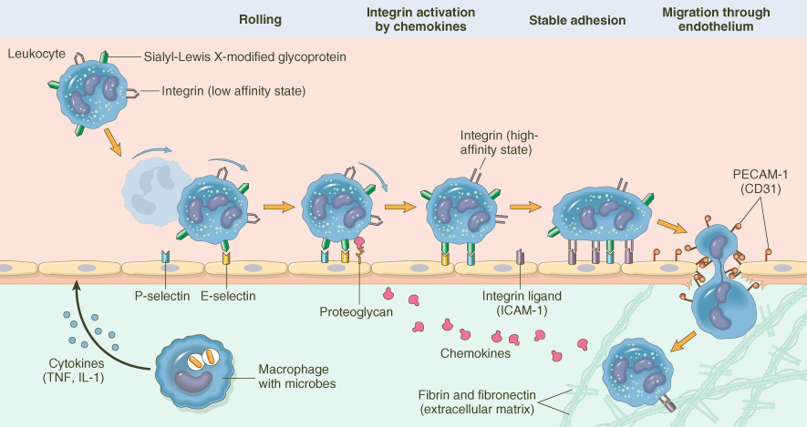
Acute inflammation
Cellular changes
Fig: The multistep process of leukocyte migration through blood vessels. The leukocytes first roll, then become activated and adhere to endothelium, then transmigrate across the endothelium, pierce the basement membrane, and migrate toward chemoattractants originate from the source of injury

Slide 56
Acute inflammation
Cellular changes
Phagocytosis and degranulation
Opsonins enhance recognition and phagocytosis of bacteria.
Important opsonins are
Fc portion of IgG,
complement system product C3b,
plasma protein collection
Engulfment
Neutrophils sends out cytoplasmic processes that surrounds the bacteria
The bacteria are internalized within a phagosome
The phagosome fuse with lysosomes (degranulation)

Slide 57
Acute inflammation
Cellular changes
Intracellular killing
Oxygen dependent killing
Respiratory brust
Requires oxygen and NADPH oxidase
Produces superoxide, hydroxyl radicals and hydrogen peroxide
Myeloperoxide
Requires hydrogen peroxide and halide (Cl⁻)
Produces HOCL (hypochlorous acid)
Oxygen independent killing
Lysozyme
Lactoferrin
Acid hydrolases
Defensins
Bacterial permeability increasing protein (BPI)

Slide 58
Acute inflammation
Chemicals mediators of inflammation
Vasoactive amines
Histamine
Produced by basophils, platelets, and mast cells
Effect: vasodilation and increased vascular permeability
Serotonin
Produced by platelets
Effect: vasodilation and increased vascular permeability
Kinin system
Activated Hageman factor (factor XII) converts prekallerian – kallikerin
Kallikerin cleaves high mol. wt. kininogen (HMWK) – bradykinin
Effects of bradykinin
Increased vascular permeability
Vasodilation
Pain
Bronchoconstriction

Slide 59
Acute inflammation
Chemicals mediators of inflammation
Arachidonic acid products
Cyclooxygenase pathway
Thromboxane A2
Produced by platelets and vascular epithelium
Vasoconstriction and platelet aggregation
Prostacyclin (PGI2)
Produced by vascular epithelium
Vasodilation and inhibit platelet aggregation
Prostaglandin E2: pain
Lipoxygenase pathway
Leucotrine B4 (LTB4): neutrophil chemotaxis
Leucotrine C4,D4,E4: vasoconstriction

Slide 60
Acute inflammation
Chemicals mediators of inflammation
The complement cascade
Important products
C5b, C9: MAC (membrane attack complex)
C3a, C5a: anaphylotoxins stimulate release of histamine
C5a: leucocyte chemotactic factor
C3b: opsonin for phagocytosis
Cytokines
IL-1 and TNF

Slide 61
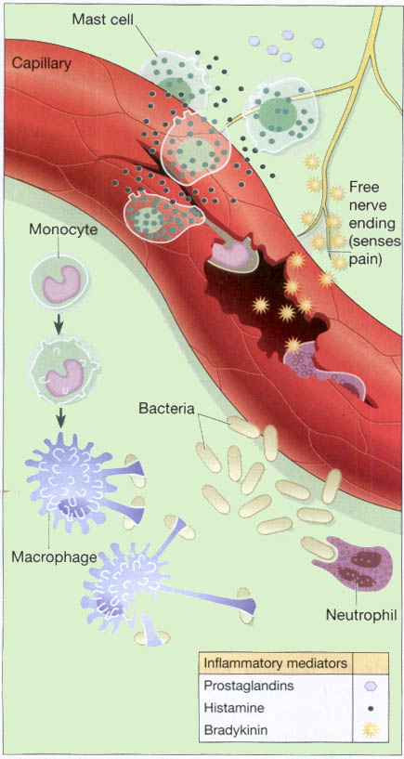
Acute inflammation
Fig: The inflammatory response.

Slide 62
Acute inflammation
Outcomes of Acute inflammation
Complete resolution with regeneration
Complete resolution with scarring
Abscess formation
Transition to chronic inflammation

Slide 63
Chronic inflammation
It is the inflammation of prolonged duration (weeks to months to years) in which active inflammation, tissue injury and healing proceed simultaneously.
Chronic inflammation is characterized by:
Infiltration with mononuclear cells, including macrophages, lymphocytes and plasma cells.
Tissue destruction, largely induced by the products of the inflammatory cells.
Repair, involving new vessel proliferation (angiogenesis) and fibrosis.

Slide 64
Chronic inflammation
Causes
Following a bout of acute inflammation
Persistent infection
Infection with certain organisms
Viral infection
Mycobacteria
Parasitic infections
Fungal infections
Autoimmune diseases
Response to foreign material
Response to malignant tumors

Slide 65
Chronic inflammation
Important cells in chronic inflammation
Macrophages
Derived from blood monocytes
Life span (60 – 120 days)
Histocytes – connective tissue
Kuffer cells – liver
Osteoclasts – bone
Microglia – brain
Alveolar macrophages – lungs
Lymphocytes
B cells and plasma cells
T cells
Eosinophils
Play role in IgE mediated allergic reaction and parasitic infestation
Granules contains MBP (major basic protein) which is toxic to parasites
Basophils
Present mostly in lungs and skin
Important role in IgE mediated reactions (allergies and anaphylaxis)
Release histamine

Slide 66
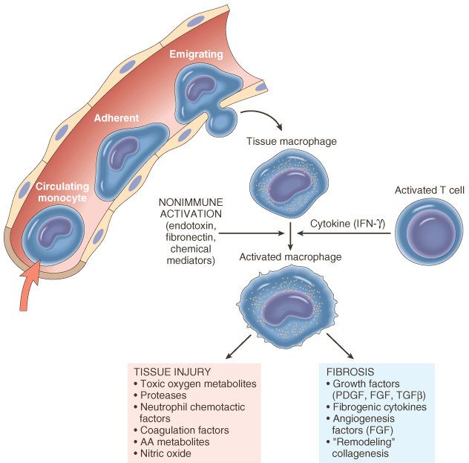
Chronic inflammation
Fig: The roles of activated macrophages in chronic inflammation. Macrophages are activated by cytokines from immune-activated T cells (particularly IFN-g) or by nonimmunologic stimuli such as endotoxin. The products made by activated macrophages that cause tissue injury and fibrosis are indicated. AA, arachidonic acid; PDGF, platelet-derived growth factor; FGF, fibroblast growth factor; TGFb, transforming growth factor b.

Slide 67
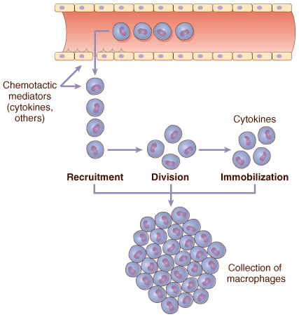
Chronic inflammation
Fig: Mechanisms of macrophage accumulation in tissues. The most important is continued recruitment from the microcirculation

Slide 68
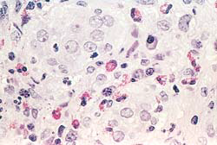
Chronic inflammation
Fig: A focus of inflammation showing numerous eosinophils.

Slide 69
Chronic inflammation
Histologic features
Infiltration with mononuclear cells, which include macrophages, lymphocytes and plasma cells, a reflection of persistent reaction to injury.
Tissue destruction, largely induced by inflammatory cells
Attempts at healing by connective tissue replacement of damaged tissue, accompanied by proliferation of small blood vessels (angiogenesis) and fibrosis and scar.

Slide 70
Chronic inflammation
Chronic granulomatous inflammation
Definition: Specialized form of chronic inflammation characterised by small aggregation of modified macrophages (epithelioid cells and multinucleated giant cells) usually surrounded by a rim of lymphocytes.
Composition of granuloma
Epithelioid cells
Multinucleated giant cells
Lymphocytes and plasma cells
Central caseous necrosis

Slide 71
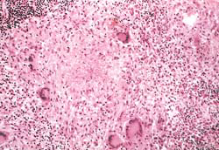
Chronic inflammation
Fig: A typical tuberculous granuloma resulting from infection with Mycobacterium tuberculosis showing an area of central necrosis, epithelioid cells, multiple giant cells, and a peripheral accumulation of lymphocytes.

Slide 72
Chronic inflammation
Granulomatous diseases
Tuberculosis
Leprosy
Fungal infection (e.g., coccidioidomycosis)
Parasitic infections (e.g., schistosomiasis)
Foreign bodies
Cat-scratch fever (small Gm -ve bacillus (Bartonella henselae). cat – reservoir – enlarged lymph node, pus formation, fever, headache, malaise)
Berylliosis (lung disease – inhalation of beryllium oxide)
Sarcoidosis (uncommon chronic inflammatory disease of unknown origin – skin and lungs)

Slide 73
Chronic inflammation
Systemic effects of chronic inflammation
Fever: mild fever with weight loss and weakness
Anemia: anemia of varying degree
Leucocytosis: relative leucocytosis
ESR: elevated ESR
Amyloidosis: secondary systemic amyloidosis (deposits of complex protein, known as amyloid)

Slide 74
Histological Patterns of Inflammation
Exudative inflammation: acute inflammatory response with neutrophils. E.g., bacterial meningitis, bronchopneumonia, abscess
Necrotising inflammation: virulent organisms producing severe tissue damage and extensive cell death. E.g., necrotising fascitis, necrotising pharyngitis
Granulomatous inflammation
Granulomatous response predominates
Slow growing organism e.g., Mycobacteria, fungi, parasites
Interstitial inflammation
Diffuse mononuclear interstitial infiltrates
Common response to viral infectious agents e.g., myocarditis (coxsackie virus), viral hepatitis
Cytopathic / cytoproliferative inflammation
Infected injured cell is altered
Intracellular/ cytopathic inclusions e.g., Rabies – Negri bodies

Slide 75
Hypersensitivity reactions

Slide 76
Introduction
Hypersensitivity refers to excessive undesirable (damaging, discomfort producing and sometimes fatal) reactions produced by the normal immune system.
It denotes an immune response resulting in exaggerated or inappropriate reaction harmful to host.
It is a harmful immune response in which tissue damage is induced by exaggerated or inappropriate immune responses in a sensitized individual on re-exposure to the same antigen.

Slide 77
Introduction
Hypersensitivity essentially has two components.
First primary dose (first dose) of antigen is essential, which is required to prime the immune system,
followed by a shocking dose (second dose) of the same antigen that results in the injurious consequences.

Slide 78
Classification
Two main types: immediate and delayed type.
Immediate form is mediated by humoral antibody and manifests in few minutes to few hours while delayed form appears more slowly, usually after 24 hours which reaches a peak after 48-72 hours and is mediated by sensitised CD4 T cells.
Exposure to foreign Ag (infective)
IMMUNITY (protective against infective agent)
HYPERSENSITIVITY
(disadvantageous reaction)
Immediate type
(antibody mediated)
Delayed type, Type IV
(T-cell mediated)
Type I
(anaphylaxis)
Type II
(cytotoxic)
Type III
(immune complex)

Slide 79
Classification
Classified into 4 groups:
Type I: IgE mediated – allergy – mast cells and basophils
Type II: IgG and IgM based – activates complement and destroys cells
Type III: Immune complexes accumulate (IgM and IgG)
Type IV: T-cell based (slow) – delayed type hypersensitivity (DTH)

Slide 80
Types of hypersensitivity reactions
Type I (anaphylactic) reaction:
Anaphylaxis (ana: against; phylaxis: protection) is a type of IgE mediated hypersensitivity reactions, which develops quickly after introduction of a large shocking dose of antigen following one or more small sensitising doses.
The reaction may involve:
skin (urticaria and eczema),
eyes (conjunctivitis),
nasopharynx (rhinorrhea, rhinitis),
bronchopulmonary tissues (asthma) and
gastrointestinal tract (gastroenteritis).
The reaction takes 15-30 minutes from the time of exposure to the antigen.
Notes:
Urticaria: The rash produced by the sudden release of HISTAMINE in the skin. It is characterised by acute itching, redness and wealing which subsides within a few minutes or may persist for a day or more.

Slide 81
Types of hypersensitivity reactions
Pathogenesis:
Type I reaction includes participation by B lymphocytes and plasma cells, mast cells and basophils, neutrophils and eosinophils.
First contact of host with antigen, sensitisation takes place; circulating B lymphocytes get activated; differentiate to form IgE-secreting plasma cells; IgE Abs bind to Fc receptors in mast cells and basophils.
Second contact with same Ag; IgE Abs on surface of mast cells-basophils are so firmly bound to Fc receptor that it sets in cell damage – membrane lysis, influx of sodium and water and degranulation of mast cells-basophils.
Released granules contain important chemical and enzymes with proinflammatory properties – histamine, serotonin, vasoactive intestinal peptides, leukotrienes B4 and D4, prostaglandins and platelet activating factors.

Slide 82
Types of hypersensitivity reactions
Pathogenesis:
The effects of these agents are:
Increased vascular permeability
Smooth muscle contraction
Vasodilation
Shock
Increased gastric secretion
Increased nasal and lacrimal secretion
Increased migration of eosinophils and neutrophils at site of injury as well as in blood (eosinophilia, neutrophilia)

Slide 83
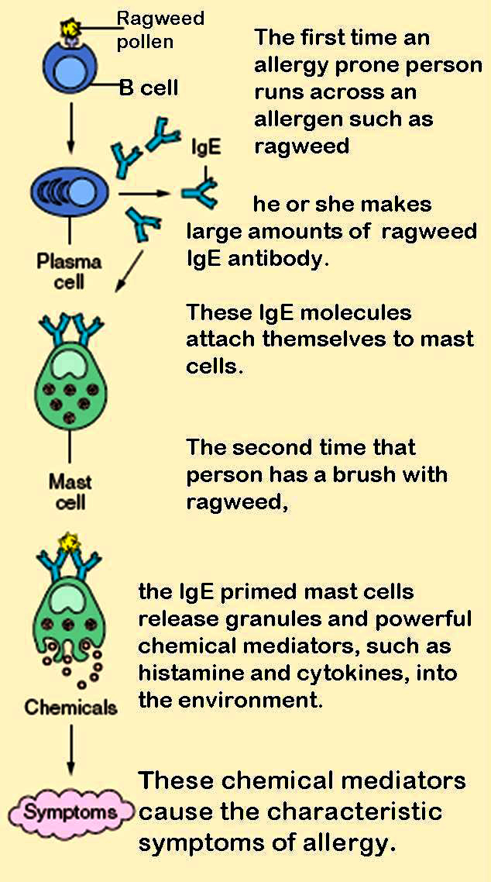
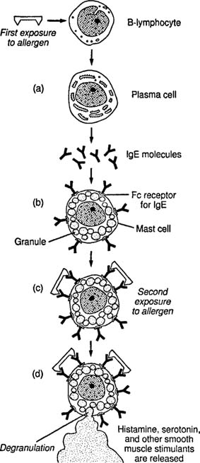
Type I

Slide 84
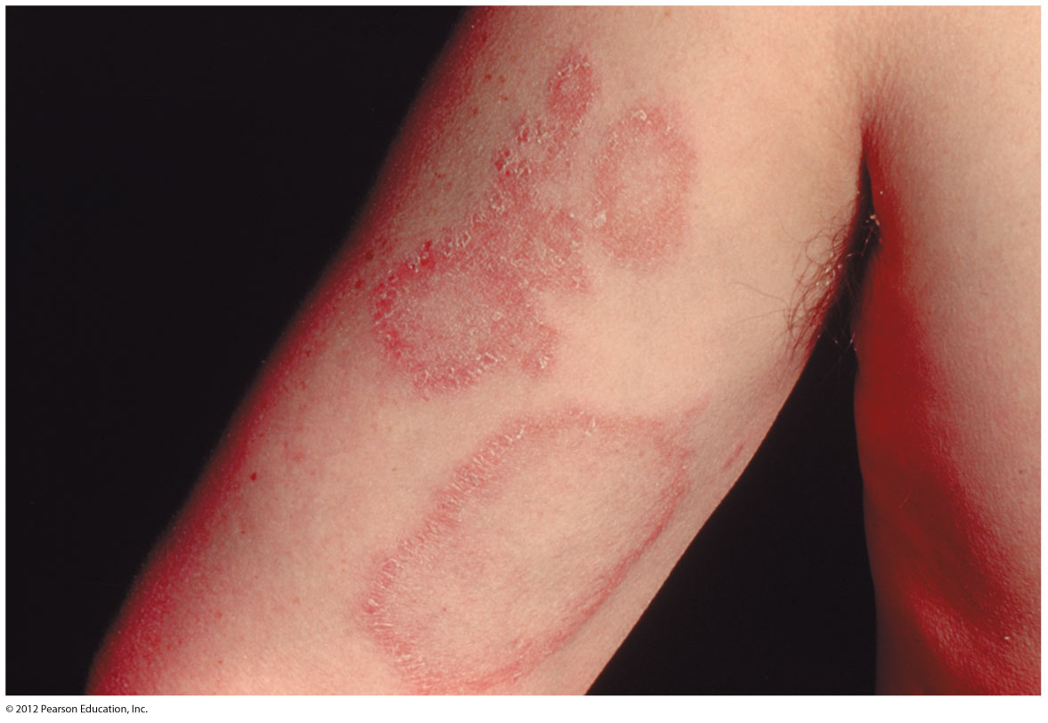
Fig: Urticaria (allergy in skin)

Slide 85
Types of hypersensitivity reactions
Type II (cytotoxic) reaction:
It is defined as reactions by humoral antibodies that attack cell surface antigens on the specific cells and tissues and cause lysis of target cells.
The reaction also takes 15-30 minutes from the time of exposure to the antigen.
Examples: autoimmune haemolytic anaemia, transfusion reactions, erythroblastosis foetalis (haemolytic disease of newborn), drug induced cytotoxic reaction (penicillin, methyl dopa, rifampicin, etc.)

Slide 86
Types of hypersensitivity reactions
Pathogenesis:
It has participation by IgG & IgM Abs, tissue macrophages, platelets, NK cells, neutrophils, eosinophils and complement system. It is tissue specific and reaction occurs after antibodies bind to tissue specific antigens, most often on blood cells.
Ag on the surface of target cell (foreign cell) attracts and binds Fab portion of the Ab (IgG or IgM) forms Ag-Ab complex.
The unattached Fc fragment of Abs forms a link between the antigen and complement.
These causes activation of classical pathway of serum complement which generates activated complement components, C3b.
Activated C3b bound to target cell, acts as opsonin and attracts phagocytes to the site of cell injury and initiates phagocytosis.
Ag-Ab complex also activates complement system and exposes membrane attack complex (MAC) that attcks and destroy the target cell.

Slide 87
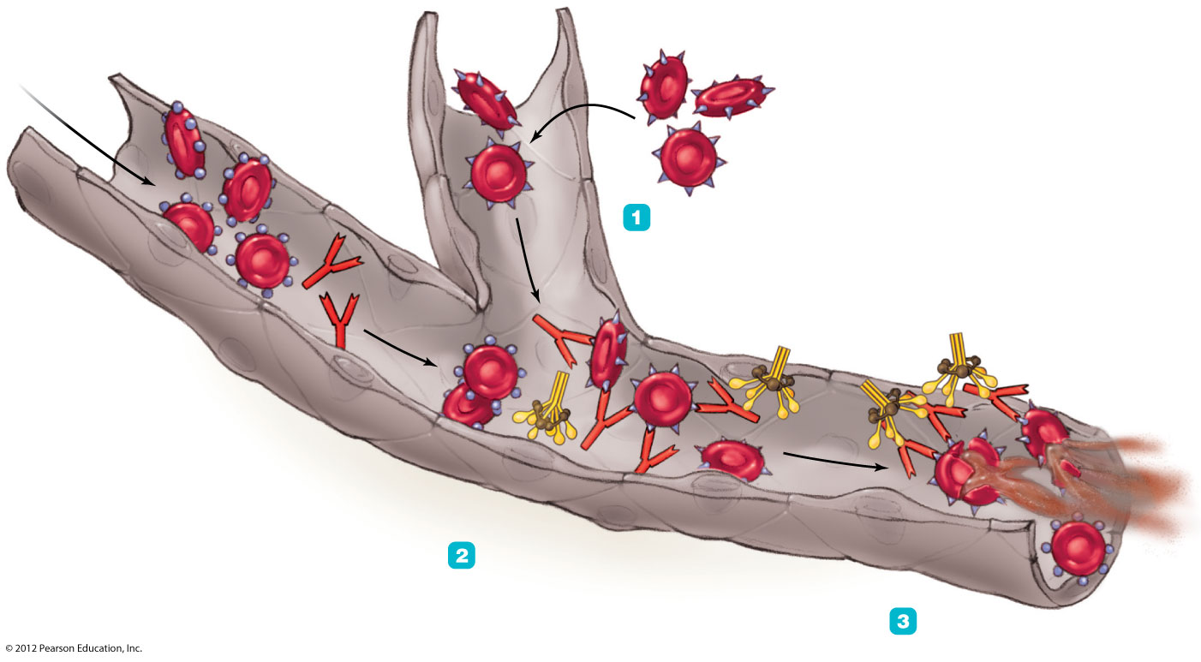
Type A antigens on red blood cells of patient
Donated red blood cells with B antigen
Anti-B antibody
Transfusion
Complement
Hemoglobin
Agglutination and complement binding
Hemolysis
Fig: Events leading to hemolysis

Slide 88
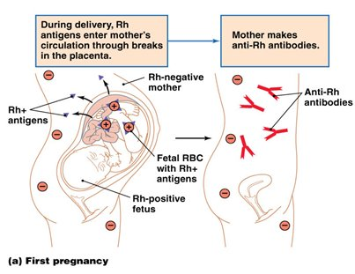
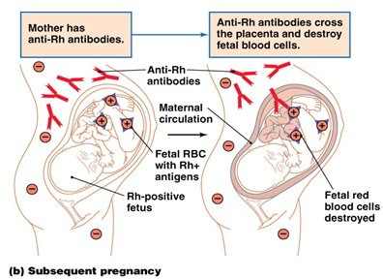
Fig: Events in the development of hemolytic disease of the newborn-overview

Slide 89
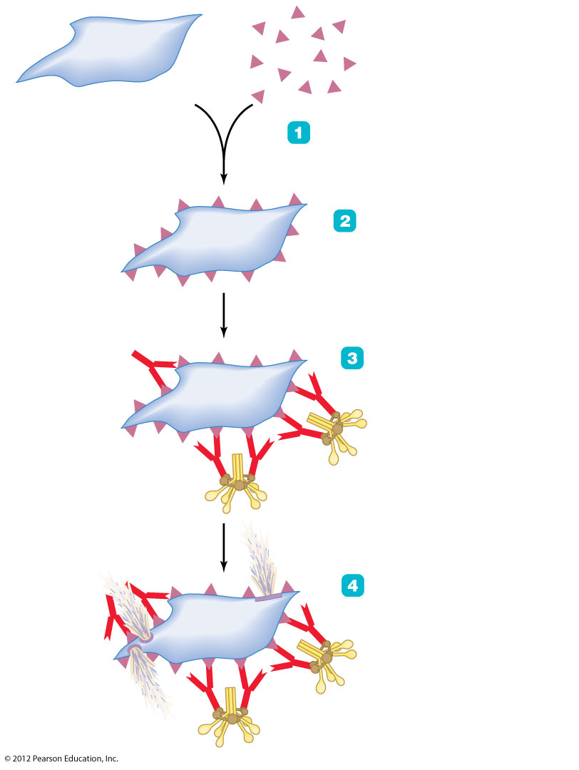
Drug
Platelet
Drug molecules bind to platelets, forming drug-platelet complex.
Drug-platelet complex
Complexes are antigenic, triggering a humoral immune
response.
Antibodies bind to drug molecules; complement binds to antibodies.
Complement
Membrane attack complexes of complement lyse platelet, which leaks cytoplasm.
Fig: Events in the development of immune thrombocytopenic purpura

Slide 90
Types of hypersensitivity reactions
Type III (Immune complex) reaction:
Type III reactions result from deposition of Ag-Ab complexes on tissues, which is followed by activation of the complement system and inflammatory reaction, resulting in cell injury.
The onset of type III reaction takes about 6 hours after exposure to the antigen.
Examples: immune complex glomerulonephritis, rheumatoid arthritis, SLE, etc.

Slide 91
Types of hypersensitivity reactions
Type III (Immune complex) reaction:
Serum Sickness
It is a disease caused by the injection of large doses of a protein antigen into the blood and characterized by the deposition of antigen-antibody complexes in blood vessel walls, especially in the kidneys and joints.

Slide 92
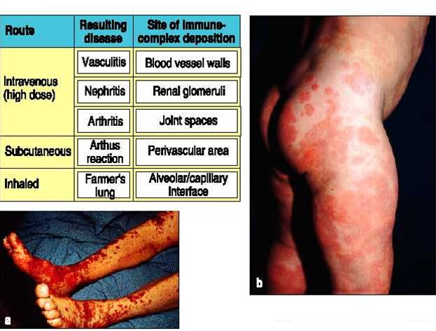
Serum Sickness

Slide 93
Types of hypersensitivity reactions
Pathogenesis of type III:
Deposition of Ag-Ab complex on tissues and subsequent sequence of cell injury takes place. It has participation by IgG & IgM Abs, neutrophils, mast cells and complement.
Immune complex are formed by interaction of soluble Ab and soluble or insoluble Ag.
Immune complex which fails to get removed from body fluid get deposited into tissues.
Fc portion of Ab links with complement resulting in formation of C3a, C5a & MAC.
C3a stimulates histamines, effects on increased vascular permeability and edema.
C5a releases proinflammatory mediators and chemotactic agents for neutrophils.
Accumulated neutrophils and macrophages in the tissue release cytokines and results in tissue destruction.

Slide 94
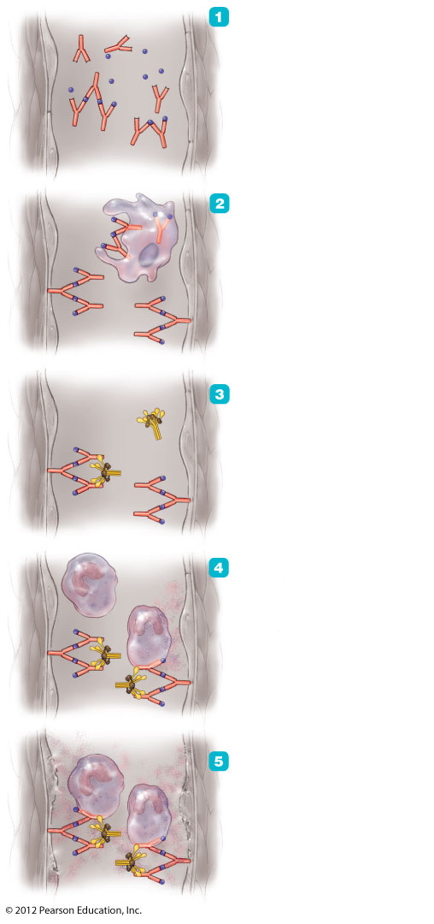
Antigens combine with antibodies
to form antigen-antibody complexes.
Antigen
Antibody (IgG)
Antigen-antibody complex
Phagocytes remove most of the
complexes, but some lodge in the walls of blood vessels.
There the complexes activate
complement.
Inactive complement
Active complement
Antigen-antibody complexes and activated
complement attract and activate neutrophils,
which release inflammatory chemicals.
Neutrophil
Inflammatory chemicals
Fig: The mechanism of type III (immune-complex mediated) hypersensitivity-overview
Inflammatory chemicals damage
Underlying blood vessel wall.

Slide 95
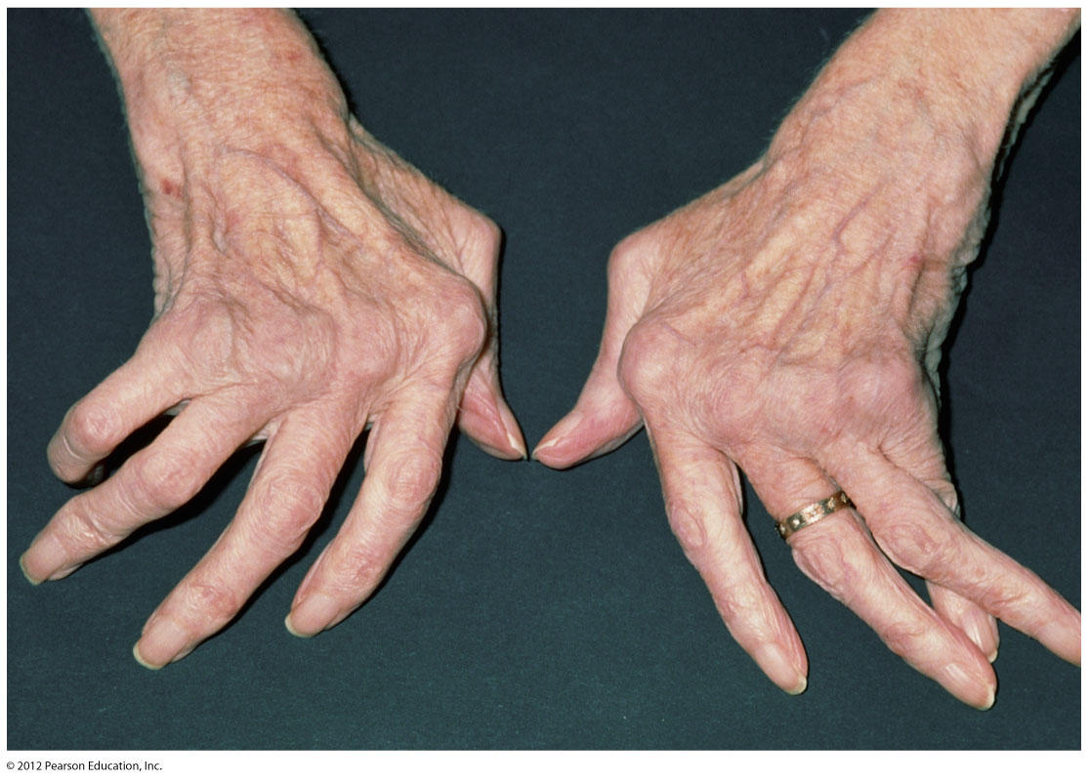
Fig: The crippling distortion of joints characteristic of rheumatoid arthritis

Slide 96
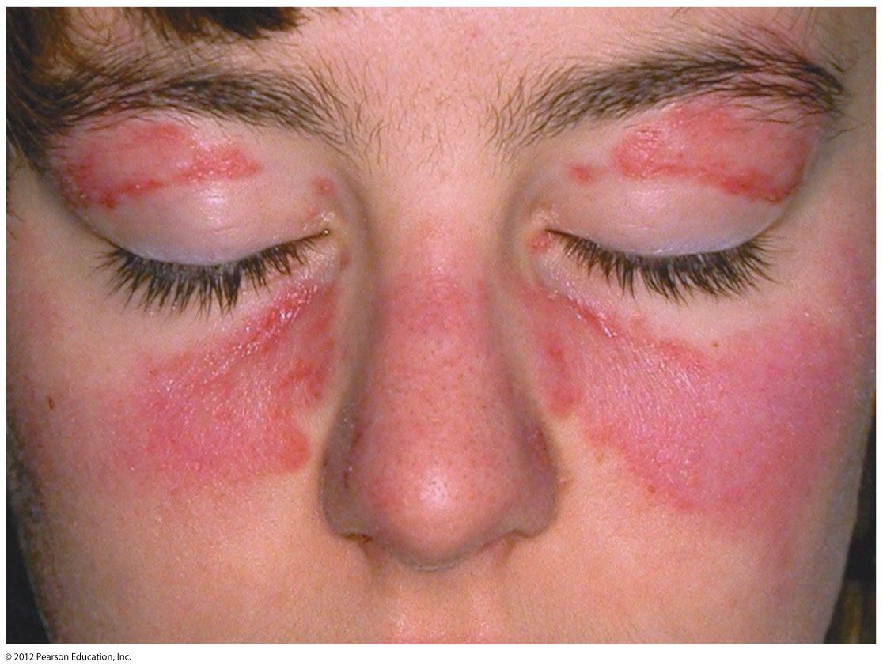
Fig: The characteristic facial rash of systemic lupus erythematosus (SLE), Type III reaction.

Slide 97
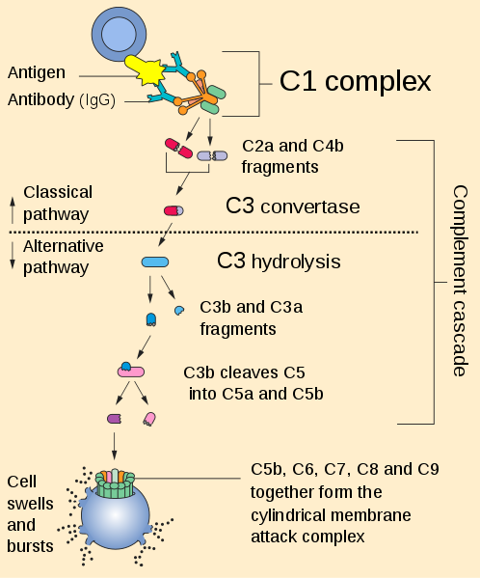
Complement system

Slide 98
Types of hypersensitivity reactions
Type IV (delayed type) reaction:
Type IV or delayed hypersensitivity reaction is tissue injury by cell mediated immune response without formation of antibodies but is instead a slow and prolonged response of specifically-sensitised T lymphocytes.
The reaction occurs about 24 hours after exposure to antigen and the effects is prolonged which may last up to 14 days.
Examples:
reaction against MTB infection e.g., tuberculin reaction,
reaction against virally infected cells,
reaction against organ transplantation e.g., transplant rejection, graft versus host reaction.

Slide 99
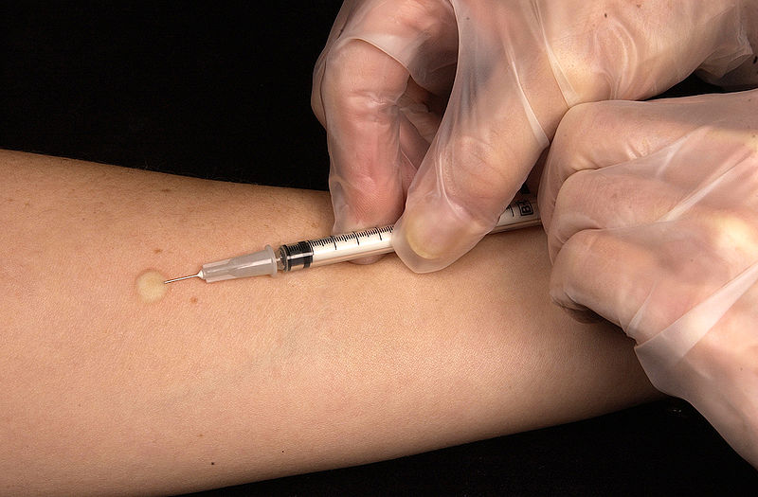
The classical example of this hypersensitivity is tuberculin (Mantoux) reaction

Slide 100
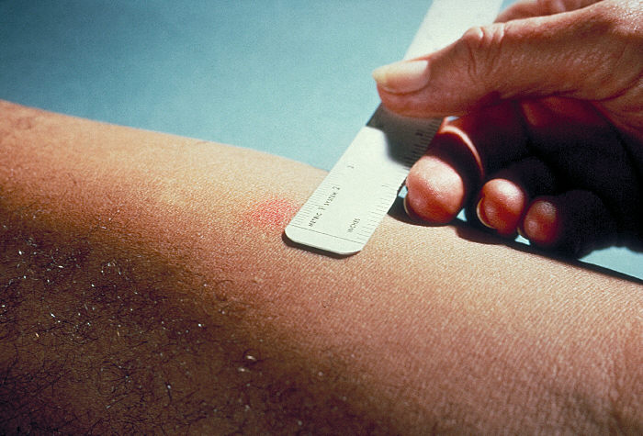
The classical example of this hypersensitivity is tuberculin (Mantoux) reaction

Slide 101
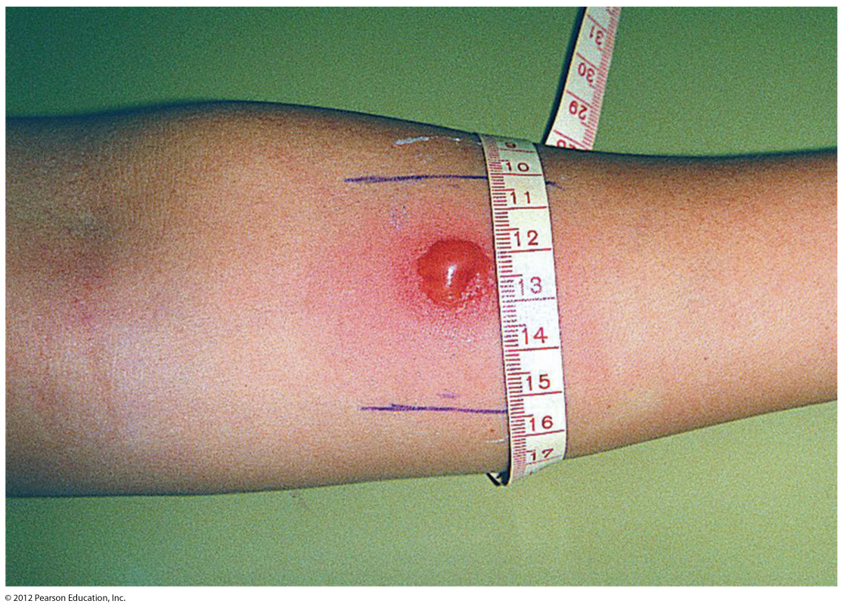
The classical example of this hypersensitivity is tuberculin (Mantoux) reaction

Slide 102
Types of hypersensitivity reactions
Pathogenesis of type IV:
Type IV reaction involves role of mast cells and basophils, macrophages and CD8+ T-cells.
Ag is recognized by CD8+ T-cells (cytotoxic T-cells) and is processed by antigen presenting cells (APCs).
APCs migrate to lymph node where Ag is presented to helper T-cells (CD4+ T-cells).
Helper T cells release cytokines that stimulate T cell proliferation and activate macrophages.
Activated T cells and macrophages release proinflammatory mediators and cause cell destruction.

Slide 103
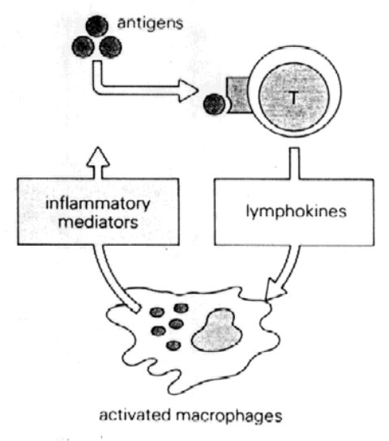
Types of hypersensitivity reactions
Pathogenesis (type IV):

Slide 104
Autoimmune disease

Slide 105
Autoimmune disease
Autoimmunity is a state in which the body’s immune system fails to distinguish between ‘self’ and ‘non-self’ and reacts by formation of autoantibodies against one’s own tissue antigen.
In other words, there is loss of tolerance to one’s own tissues; autoimmunity is the opposite of immune tolerance.
Immune tolerance is a normal phenomenon present since foetal life and is defined as the ability of an individual to recognise self tissue and antigens.
Normally, the immune system of the body is able to distinguish self from non-self antigens.

Slide 106
Autoimmune disease
The mechanisms by which the immune tolerance of the body is broken causes autoimmunity.
These mechanisms or theories of autoimmunity may be immunological, genetic and microbial, all of which may be interacting.

Slide 107
Autoimmune disease
Types:
Organ specific diseases:
The autoantibodies formed react specifically against an organ or target tissue component and causes its chronic inflammatory destruction.
The tissues affected are endocrine glands (thyroid, pancreatic islets of Langerhans, adrenal cortex), alimentary tract, blood cells, etc.
Organ non-specific (systemic) disease:
These are diseases in which a number or autoantibodies are formed which react with antigen in many tissues and thus cause systemic lesions.
These includes Systemic Lupus Erythematosus (SLE), rheumatoid arthritis, etc.

Slide 108
Autoimmune disease
Systemic Lupus Erythematosus (SLE)
It is the systemic autoimmune collagen disease, ‘lupus’ Latin word meaning ‘wolf’, believed to affect skin only and eat always skin like a wolf.
Connective tissue disease that mainly affects the skin, blood, joints and kidneys.
Occurs predominantly in women of childbearing age.
The disease is characterized by the presence of autoantibodies, which form immune complexes with autoantigens and are deposited within the kidney glomeruli.
The resulting type III hypersensitivity is responsible for the glomerulonephritis (Inflammation of blood capillary vessels in the glomeruli).

Slide 109
Autoimmune disease
Systemic Lupus Erythematosus (SLE)
Systemic or disseminated form:
It is characterized by acute and chronic inflammatory lesions widely scattered in the body and there is presence of various nuclear and cytoplasmic autoantibodies in the plasma.
Discoid form:
It is characterized by chronic and localised skin lesions involving the bridge of nose and adjacent cheeks without any systemic manifestation.

Slide 110
Autoimmune disease
Systemic Lupus Erythematosus (SLE)
Etiology: Exact etiology is unknown, however autoantibodies against nuclear and cytoplasmic components of the cells are demonstrable in plasma by Immunofluorescence tests in almost all cases of SLE.
Antinuclear antibodies (ANAs)
Antibodies to double-stranded (anti-dsDNA)
Anti-Smith antibodies (anti-Sm)
Anti-ribonucleoprtoeins (anti-RNP)
Anti-histone antibody
Others

Slide 111
Autoimmune disease
Systemic Lupus Erythematosus (SLE)
Pathogenesis:
The autoantibodies formed are the mediators of tissue injury in SLE.
Two types of immunologic tissue injury:
Type II hypersensitivity is characterized by formation of autoantibodies against blood cells (red blood cells, platelets, leucocytes) and results in haematologic derangement in SLE.
Type III hypersensitivity is characterized by antigen-antibody complex (commonly DNA-anti-DNA antibody) which is deposited at sites such as renal glomeruli, wall of small blood vessels, etc.

Slide 112
Autoimmune disease
Systemic Lupus Erythematosus (SLE)
LE cell phenomenon:
First diagnostic laboratory test described for SLE.
The test is based on the principle that ANAs cannot penetrate the intact cells and thus cell nuclei should be exposed to bind them with the ANAs.
The binding of exposed nucleus with ANAs results in homogenous mass of nuclear chromatin material which is called LE body.
LE cell is a phagocytic leucocyte, commonly polymorphonuclear neutrophils, and sometimes a monocytes, which engulf the homogenous nuclear material of the injured cell.

Slide 113
Autoimmune disease
Systemic Lupus Erythematosus (SLE)
Clinical features:
Targeted organs are musculoskeletal system, skin, kidneys, nervous system, lungs, heart and blood vessels, GI system, haematopoietic system.
Fatigue and myalgia (pain in a muscle) are present.
Severe illness with fever, weight loss, anaemia and organ related manifestations.

Slide 114
Autoimmune disease
Systemic Lupus Erythematosus (SLE)
Diagnosis:
Four or more diagnostic criteria must be fulfill:
Malar rash (erythema, flat or raised over malar eminences (butterfly rash)
Discoid rash (erythematous circular raised patches)
Photosensitivity (rash on exposure to sunlight)
Oral ulcers
Non-erosive arthritis (affecting two or more joints, swelling, tenderness, effusion)
Serositis (as pleuritis or pericarditis)
Renal manifestation
Neurological manifestation
Haematologic derangements (hemolytic anaemia, thrombocytopenia, leucopenia)
Immunological derangements (positive test for anti-dsDNA, etc.)
Antinuclear antibodies (by Immunofluorescence)

Slide 115
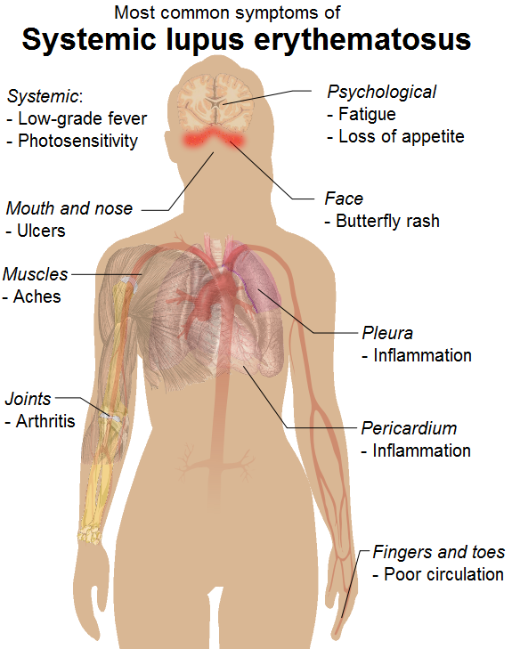

Slide 116
Fig: The characteristic facial rash of systemic lupus erythematosus (SLE), Type III reaction.

Slide 117
HIV and AIDS

Slide 118
HIV and AIDS
HIV: Human Immunodeficiency Virus
AIDS: Acquired Immunodeficiency Syndrome
AIDS is caused by an RNA retrovirus called human immunodeficiency virus (HIV) which is a type of human T cell leukemia-lymphoma virus (HTLV).
It is characterized by infection and depletion of CD4+ T lymphocytes, and by profound immunosupression leading to opportunistic infections, secondary neoplasms, and neurological manifestations.
AIDS is end-stage disease of HIV infection which denotes irreversible breakdown of immune system of the host.

Slide 119
HIV and AIDS
Epidemiology
First described in United States in 1981; but now been reported in every country in the world.
Worldwide, more than 22 millions people have died of AIDS, about 42 million people are living with the disease and about 5 million infections each year.
Worldwide, 95% of HIV infections are in developing countries, with Africa alone carrying more than 50% of the HIV burden.
Although largest number of infection is in Africa, the most rapid increase in HIV infection in the past decades are in southeast Asian countries, including Thailand, India and Indonesia.

Slide 120
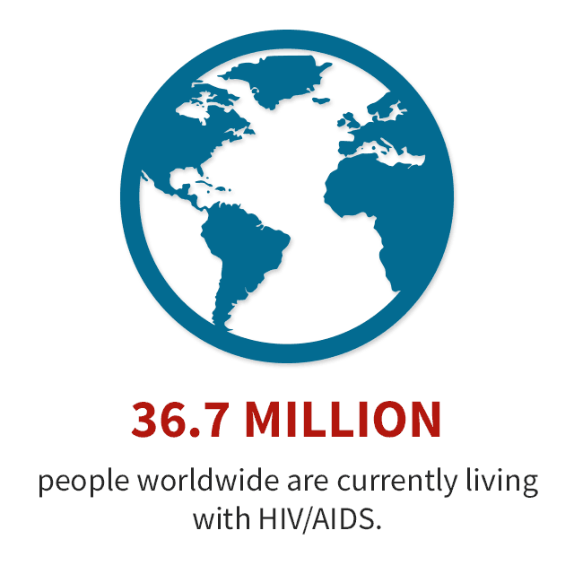
HIV and AIDS
Epidemiology
WHO data on HIV IN 2019:
People living with HIV: 37.9 millions
People on antiretroviral therapy: 24.5 millions
People became newly infected with HIV: 1.7 million
Mother to child transmission: 7 out of 10 pregnant women living with HIV
37.9 MILLION

Slide 121
HIV and AIDS
Structure
HIV-I virus particles is spherical in shape and 100-140 nm in size.
It contains a core having core particles, p24 and p18, two strands of genomic RNA and the enzyme, reverse transcriptase.
The core is covered by a double layer of lipid membrane derived from the outer membrane of infected host cell during budding process of virus.
The membrane studded with 2 envelope glycoproteins, gp120 and gp41.
Three important genes codes for the respective components of virion:
gag (group antigen) for core proteins
pol (polymerase) for reverse transcriptase, and
env (envelope) for the envelope proteins.

Slide 122
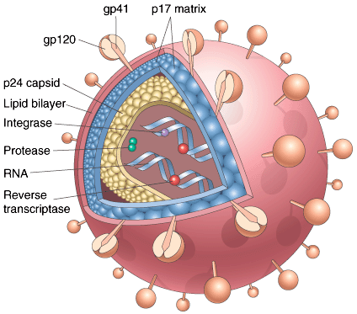
HIV and AIDS
Fig: Schematic illustration of an HIV virion. The viral particle is covered by a lipid bilayer that is derived from the host cell.

Slide 123
HIV and AIDS
Route of Transmission
Sexual transmission
Transmission via blood and blood products
Perinatal transmission
Occupational transmission
Transmission may by other body fluids (saliva, tears, sweat, urine, semen, vaginal and cervical secretions, breast milk, CSF, etc. and should come in contact with blood)
AIDS cannot be transmitted by casual non-sexual contact like shaking hands, hugging, sharing household facilities like beds, toilets, utensils, etc.
Sterilization and disinfection: by the use of sodium hypochlorite, formaldehyde (5%), ethanol (70%), glutaraldehyde (2%), heating at 56 ⁰C for 30 mins.
Notes:
Zidovudine, didanosine, zalcitabine

Slide 124
HIV and AIDS
Pathogenesis:
The pathogenesis of HIV infection is largely related to the depletion of CD4+ T cells (helper T cells) resulting in profound immunosupression.
Selective tropism for CD4 molecule receptor: (gp120 env protien)
Internalisation: (entry of virus in CD4 cell)
Uncoating and viral DNA formation: (viral RNA ssDNA (reverse transcriptase) dsDNA (DNA polymerase))
Viral integration: (Viral DNA integrates into host cell DNA)
Viral replication: (many virus particles are produces)
Latent period and immune attack: (overpowers the host immune system)
CD4+ T cell destruction: (destruction of CD4 cells)
Viral dissemination: (and finally releases and attacks other CD4 cells, immune cells and other body cells; produces viraemia).
Notes:
Chemokines receptors: CCR5, CXCR4..

Slide 125
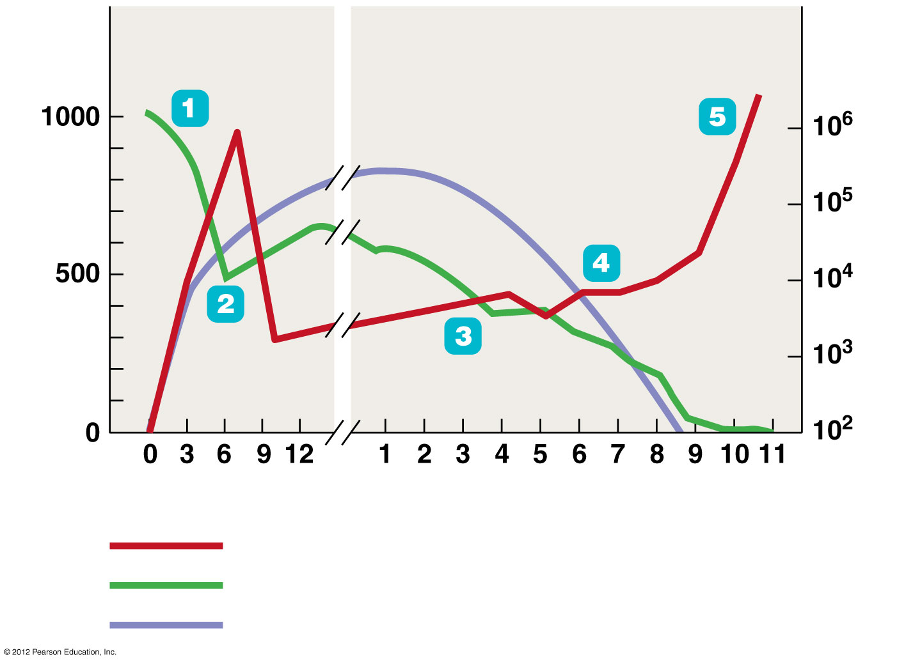
Fig: The course of AIDS
Opportunistic diseases
Death
Primary infection
Clinical latency
CD4 T cells/mm³ blood
HIV RNA copies/ml plasma
Weeks
Years
HIV in blood
CD4 (helper) T cell count
Antibody against HIV

Slide 126

Fig: The global distribution of HIV/AIDS
HIV and AIDS
Eastern Europe & Central Asia 1.5 million
Western and Central Europe 850,000
North America 1.4 million
East Asia & Pacific 850,000
South & Southeast Asia 3.8 million
Caribbean 240,000
North Africa & Middle East 310,000
Latin America 2 million
Sub-Saharan Africa 24.4 milion
Australia & New Zealand 59,000

Slide 127
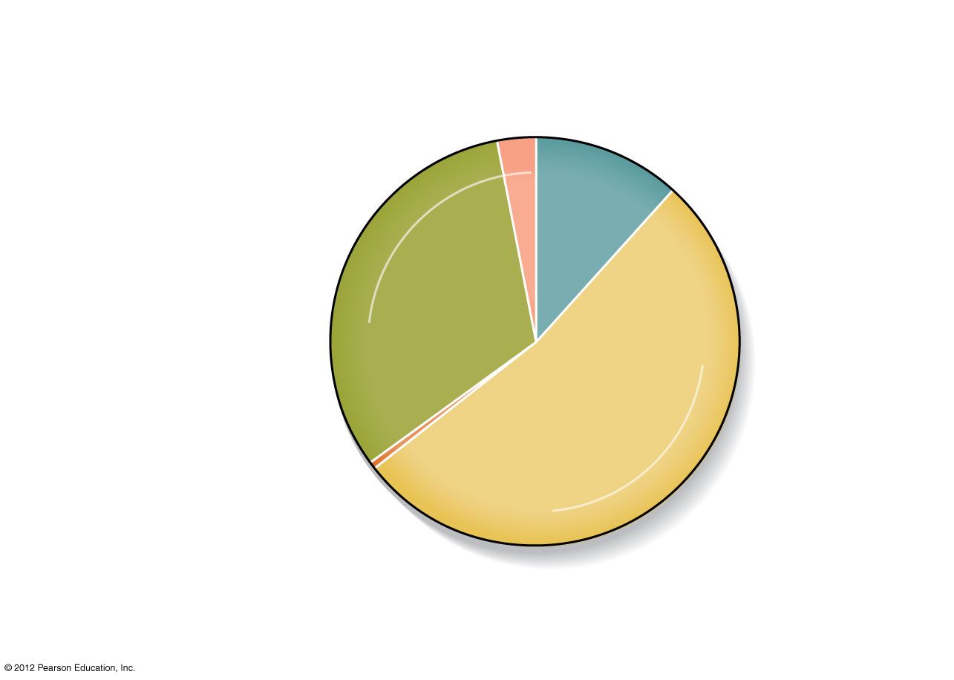
Fig: Modes of HIV transmission in males
HIV and AIDS
Male homosexual contact plus use of injected drugs
Use of injected drugs
3%
12%
32%
Heterosexual contact
53%
Other <0.5%
Male homosexual contact
Adult Males

Slide 128
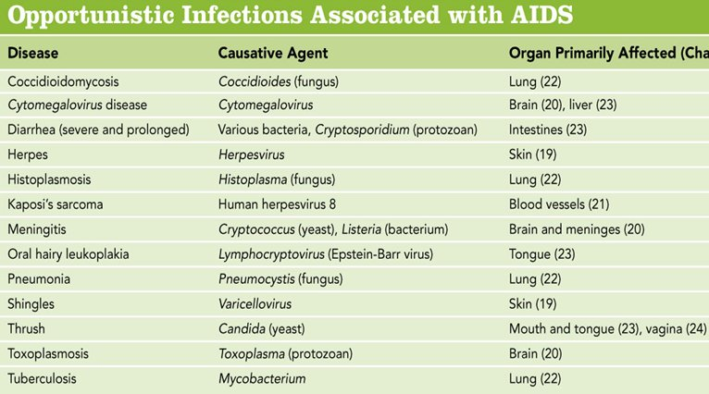
HIV and AIDS

Slide 129
Shock

Slide 130
Shock
Definition
It is a clinical syndrome characterized by decreased blood supply to body tissue.
Shock or cardiovascular collapse constitute systemic hypoperfusion due to reduction either in cardiac output or in the effective circulating blood volume whose end results are hypotension followed by impaired tissue perfusion and cellular hypoxia.

Slide 131
Shock
Types of shock
Cardiogenic shock (pump failure)
Hypovolaemic shock (reduced blood volume)
Septic shock (bacterial infection)
Neurogenic shock
Anaphylactic shock
Cardiogenic shock (pump failure)
Myocardial infarction
Cardiac arrhythmias
Pulmonary embolism
Rupture of heart, ventricles or papillary muscles
Cardiomyopathies
Failure of myocardial pump due to intrinsic myocardial damage, extrinsic pressure or obstruct to outflow.

Slide 132
Shock
Hypovolaemic shock (reduced blood volume)
Acute haemorrhage
Dehydration from vomiting, diarrhoea
Burns or trauma
Excessive use of diuretics
Acute pancreatitis
Septic shock
Gram-negative septicaemia (endotoxic shock) e.g., infection with E. coli, Proteus, Klebsiella, Pseudomonas, etc.
Gram-positive septicaemia (exotoxic shock) e.g., infection with streptococci, pneumococci

Slide 133
Shock
Neurogenic shock
High cervical spinal cord injury
Accidental high spinal anaesthesia
Severe head injury
Hypotension
Bradycardia
Anaphylactic shock
Caused by type I hypersensitivity
IgE mediated
Reaction to the drugs and other allergens
e.g., bronchospasm, hypotension

Slide 134
Pathogenesis of Shock
↓ Effective circulating blood volume
Hypovolaemic,
Septic shock
↓ Venous return to heart
↓ Cardiac output
Cardiogenic,
Neurogenic,
others
↓ Blood flow
↓ Supply of oxygen
Anoxia
Inflammatory mediators
Shock

Slide 135
Pathophysiology (Stages of shock)
1. Compensated shock:
Non- progressive, initial, reversible shock
Maintain adequate cerebral and coronary blood supply by redistribution of blood so that the vital organs (brain and heart) are adequately perfused and oxygenated.
It is achieved by:
Widespread vasoconstriction
Activation of neural and humoral factors (baroreceptors, chemoreceptors, catecholamines, renin and angiotensin-II)
Effects: tachycardia, increased blood pressure and peripheral resistance, cool clammy skin
Fluid conservation by kidney
Activation of renin-angiotensin-aldosterone mechanism, release ADH, reduced glomerular filtration rate (GFR), shifting of tissue fluids into plasma
Stimulation of adrenal medulla
Release of catecholamines (epinephrine and non-epinephrine) which increase heart rate and cardiac output.

Slide 136
Pathophysiology (Stages of shock)
Progressive decompensated shock
During which there is widespread tissue hypoxia.
Patients suffers from some other stresses or risk factors (e.g., pre-existing cardiovascular or lung disease), progressive deterioration.
Effects:
Pulmonary hypoperfusion and increased vascular permeability.
Tissue ischemia; aerobic response is replaced by anaerobic glycolysis with production of lactic acid, lowers pH, vasodilation and peripheral pooling of blood occurs; leads to decrease cardiac output and urinary output, mental confusion.

Slide 137
Pathophysiology (Stages of shock)
Irreversible decompensated shock
Irreversible tissue injury and organ failure ultimately resulting in death.
Lysozymal enzyme leakage causes widespread cell injury.
Myocardial contractility worsens and septic shock may superimpose.
At this point there is complete renal shut down due to active tubular necrosis.
Despite various measures, the clinical condition deteriorates which may end to death.
Largely affects heart, brain, lungs, kidney, liver, GI, blood, etc.

Slide 138
Edema

Slide 139
Edema
Approximately 60% of lean body weight is water; two thirds of this water is intracellular, and the remainder is found in the extracellular space, mostly as interstitial fluid (only about 5% of total body water is in blood plasma).
The term edema signifies increased fluid in the interstitial tissue spaces.
In addition, depending on the site, fluid collections in the different body cavities are variously designated hydrothorax, hydropericardium, and hydroperitoneum (ascites).
Anasarca is a severe and generalized edema with profound subcutaneous tissue swelling.

Slide 140
Edema
Hence, it is a extravasation of fluid from vessels into interstitial spaces; the fluid may be protein poor (transudate) or may be protein rich (exudate).
Edema results from any of the following conditions:
Increased hydrostatic pressure, caused by a reduction in venous return (as in heart failure)
Decreased plasma/colloid osmotic pressure, caused by reduced concentration of plasma albumin (due to decreased synthesis, as in liver disease, or increased loss, as in kidney disease)
Lymphatic obstruction that impairs interstitial fluid clearance (as in scarring, tumors, or certain infections)
Primary renal sodium and water retention (in renal failure)
Increased vascular permeability (in inflammation)

Slide 141
Thrombosis

Slide 142
Thrombosis
Thrombosis is the process of formation of solid mass in circulation from the constituents of flowing blood; the mass itself is called a thrombus.
In contrast, a blood clot is the mass of coagulated blood formed in vitro e.g., in a test tube.
Haematoma is the extravascular accumulation of blood clot e.g., into the tissues.
Haemostatic plugs are the blood clots formed in healthy individuals at the site of bleeding e.g., in injury to the blood vessel.
Normally, blood flowing through blood vessels do not clot because of smooth endothelial wall of vessels, normal blood flow and anticoagulants flowing in the blood.
When derangements in above mentioned factors occurs then blood may coagulate in blood vessels which is known as thrombosis.

Slide 143
Thrombosis
Pathogenesis
Factors involved in thrombus formation (Virchow's Triad):
Endothelial injury
Atherosclerosis
Vasculitis
Many others
Alterations in laminar blood flow
Stasis of blood (e.g., immobilization)
Turbulence (e.g., aneurysms)
Hyperviscosity of blood (e.g., polycythemia vera)
Notes:
Turbulance : abnormal haphazard flood of blood, Stasis: abnormal pooling of blood. Vasculitis: Inflammation of the blood vessels. This may damage the lining of the vessels and cause narrowing or blockage, thus restricting blood flow.

Slide 144
Thrombosis
Pathogenesis
Hypercoaguability of blood
Clotting disorders (deficiency of antithrombin III, protein C, or protein S)
Tissue injury (post-operative and trauma)
Neoplasia
Nephrotic syndrome
Advanced age
Pregnancy
Oral contraceptives

Slide 145
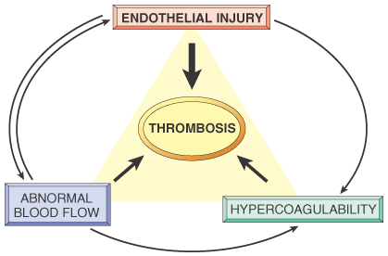
Thrombosis
Fig: Virchow triad in thrombosis. Endothelial integrity is the single most important factor. Note that injury to endothelial cells can affect local blood flow and/or coagulability; abnormal blood flow (stasis or turbulence) can, in turn, cause endothelial injury. The elements of the triad may act independently or may combine to cause thrombus formation.

Slide 146
Thrombosis
Table : Comparison of a Thrombus with a Blood Clot
 | Thrombus | Blood clot
Location | Intravascular | Extravascular or intravascular (postmortem)
Composition | Platelets Fibrin RBCs and WBCs | Lacks Platelets; Fibrin RBCs and WBCs
Lines of Zahn | Present | Absent
Shape | Has shape | Lacks shape
Line of Zahn: Lamination (layers) formed by alternating layers of platelets mixed with fibrin and darker layer containing RBCs.
Notes:
Line of Zahn: lamination formed by alternating layers of platelets mixed with fibrin and darker layer containing RBCs.

Slide 147
Thrombosis
Common locations of thrombus formation
Coronary and cerebral arteries
Heart chambers atrial fibrillation or post-MI
Aortic aneurysms (swelling / dilatation of an artery due to weakening of its wall)
Heart valves
Deep leg veins (deep vein thrombosis-DVTs)
Outcomes of thrombosis
Vascular occlusion and infarction
Embolism
Thrombolysis
Organization and recanalization (reopen)

Slide 148
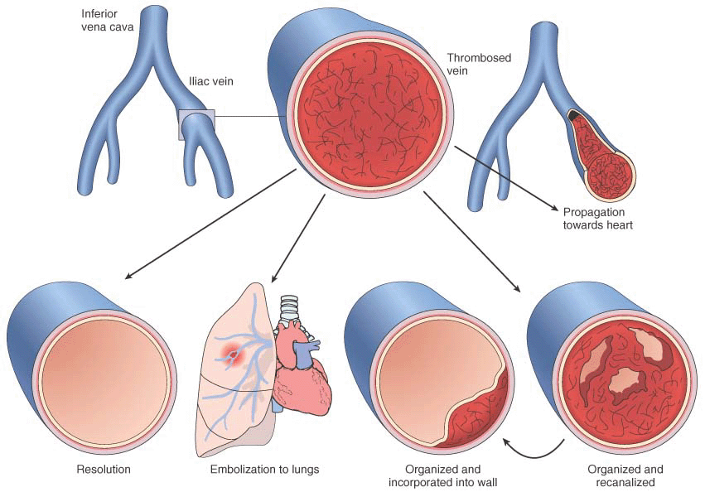
Thrombosis
Fig: Potential outcomes of venous thrombosis.

Slide 149
Embolism

Slide 150
Embolism
Any intravascular mass that has been carried down the bloodstream from its site of origin, resulting in the occlusion of a vessel is known as embolism.
Embolus: an embolus is a detached intravascular solid, liquid or gaseous mass that is carried by blood to a distant site from its site of origin.
Most usual forms of emboli (90%) are thromboemboli i.e. originating from thrombi or their parts detached from the vessel wall.

Slide 151
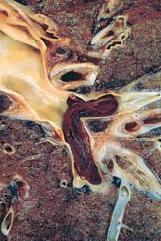
Embolism
Fig: Large embolus derived from a lower extremity deep venous thrombosis and now impacted in a pulmonary artery branch.

Slide 152
Embolism
Types:
Thromboemboli – most common (98%)
Atheromatous emboli – severe atherosclerosis
Fat emboli – bone fractures and soft-tissue trauma
Bone marrow emboli – bone fractures
Gas emboli – decompression sickness
Amniotic fluid emboli – complication of labor
Tumor emboli – metastasis
Talc emboli – intravenous drug abuse (IVDA)
Bacterial/septic emboli – Infectious endocarditis
Notes:
Decompression sickness: Decompression sickness is caused by a rapid change in ambient pressure and is a disease associated with deep-sea divers, tunnel workers and high-flying aviators.

Slide 153
Embolism
1. Pulmonary emboli (PE)
Often clinically silent
Most commonly missed diagnosis in hospitalized patients
Found in almost half of all hospital autopsies
Morphology:
It involves the lower lobes of the lung.
Produces wedge shaped infarct which is grayish brown and hemorrhagic.
The overlying pleura is thick and fibrinous.
The infracted are later undergo fibrosis and forms a scar tissue.

Slide 154
Embolism
1. Pulmonary emboli (PE)
Pathology
Most (95%) arise in deep leg veins thrombosis (DVT)
Pelvic venous plexuses of the prostate and uterus
Right side of the heart
Clinical features:
Chest pain
Difficulty in breathing
Shock
Cough
Tachycardia
Hemoptysis
Pleural pain

Slide 155
Embolism
1. Pulmonary emboli (PE)
Potential outcomes of PEs
No sequela (75%) (i.e., not any condition or disorder subsequent to disease)
No infarction (dual blood supply)
Complete resolution
Infarction (15%)
More common in patients with cardiopulmonary compromise
Shortness of breath (SOB), hemoptysis, pleuritic chest pain, pleural effusion
Regeneration or scar formation
Sudden death (5%) (Large emboli may lodge)
Chronic pulmonary hypertension (3%) (Caused by recurrent PEs)

Slide 156
Embolism
Pulmonary emboli Prevention
Pulmonary embolism is preventable condition
It can be avoided by:
Giving isometric leg exercise
Prophylactic therapeutics measures (e.g. use of anticoagulant therapy with heparin, warfarin)
Embolectomy or thrombolysis (streptokinase)
Diagnosis
Doppler ultrasound of the leg veins to detect a DVT
Plasma-D-dimer ELISA test is elevated. (a protein measured in a blood to diagnose thrombosis)

Slide 157
Embolism
2. Systemic arterial emboli
Refers to the emboli travelling within arterial circulation
Most arise in the heart
Most cause infarction
Common sites of infarction
Lower extremities
Brain
Intestine
Kidney
Spleen

Slide 158
Infarction

Slide 159
Infarction
Definition: localized area of necrosis secondary to ischemia
Pathogenesis
Most infarcts (99%) result from thrombotic or embolic occlusion of an artery or vein
Vasospasm
Torsion (twisting) of arteries and veins (e.g., volvulus, ovarian torsion)
Notes:
Volvulus: An obstruction of the bowels produced by the twisting of a loop of bowel round itself. Torsion: the act of twisting, the force which causes twisting, or the state of being twisted

Slide 160
Infarction
Factors that predict the development of an infarct:
Vulnerability/possibility of the tissue to hypoxia
Degree of occlusion
Rate of occlusion
Presence of a dual blood supply or collateral circulation
Oxygen-carrying capacity of the blood
Common sites of infarction:
Heart
Brain
Lungs
Intestines

Slide 161
Infarction
Gross pathology of infarction
Often has a wedge shape
Apex of the wedge tends to point to the occlusion
Anemic infarcts (pale or white color)
Occur in solid organs with a single blood supply such as the spleen, kidney, and Heart
Hemorrhagic infarcts (red color)
Occur in organs with a dual blood supply or collateral circulation, such as the lung and intestines
Also occur with venous occlusion (e.g., testicular torsion)

Slide 162
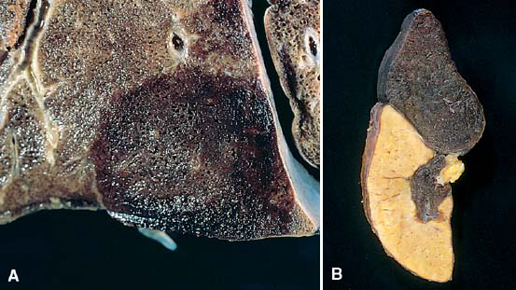
Infarction
Fig: Examples of infarcts. A, Hemorrhagic, roughly wedge-shaped pulmonary infarct.
B, Sharply demarcated white infarct in the spleen.

Slide 163
Infarction
Microscopic pathology of infarction
Coagulative necrosis – most organs
Liquefactive necrosis – brain
General sequence of tissue changes after infarction:
Ischemia → coagulative necrosis → inflammation → granulation tissue → fibrosis → infarction

Slide 164
Infarction
Coagulative necrosis | Liquefactive necrosis | Caseous necrosis | Fat necrosis
Most common type of necrosis Associated with ischemia Gross Appearance: tissue is firm and architecture is maintained for days after cell death. Microscopic: Preserved cell outlines without nuclei. Seen in all organs (heart, liver, kidney, etc.) except BRAIN | Enzymatic destruction of cells Seen in BRAIN, Pancreatitis Gross Appearance: The tissue is in a liquid form and sometimes creamy yellow because of Abscess/pus formation. Microscopic: Inflammatory cells with numerous neutrophils. | Combination of Coagulative & liquefactive necrosis Characteristic of TB Gross Appearance: White, soft, cheesy-looking (caseating) material Microscopic: A uniformly central necrosis surrounded by a collar of lymphocytes and activated macrophages (giant cells, epithelioid cells). | Action of lipases on fatty tissues Seen in breast, omentum and pancreatitis Gross Appearance: Whitish deposits as a result of the formation of calcium soaps. Microscopic: Anucleated adipocytes with deposits of calcium

Slide 165
Neoplasia

Slide 166
Neoplasia
The term ‘neoplasia’ literally means new growth; the new growth produced is called ‘neoplasm’ or ‘tumor’.
All new growth are not neoplasms e.g., embryogenesis, regeneration, repair.
Proliferate throughout life (labile cells; e.g. squamous epithelium of the skin)
Limited proliferation (stable cells; e.g. hepatocytes )
Do not replicate (permanent cells; e.g. nerve cells, skeletal muscle cells, and cardiac muscle cells)
Neoplasm or tumor is a mass of tissue formed as a result of abnormal, excessive, uncontrolled, autonomous and purposeless proliferation of cells even after cessation of stimulus for growth which caused it.

Slide 167
Neoplasia
The study of tumors is called oncology (from oncos, “tumor”, and logos, “study of”).
Terminologies:
Differentiation: (degree of similarity of tumor cells to the cells of organs in which they arose) refers to the extent to which parenchymal cells resemble comparable normal cells, both morphologically and functionally. In general, benign tumors are well differentiated and malignant tumors are lack of differentiation.
Dysplasia: means disordered growth. Mainly seen in epithelium and include a loss in uniformity of individual cells as well as loss in their architectural orientation.
Metastasis: the distant spread of malignant tumor from the site of origin. This occurs through blood stream, lymphatic system and across body cavities.

Slide 168
Neoplasia
Terminologies:
Anaplasia: lack of differentiation/normal cell characteristics which may to such a degree that is impossible to define origin of the cell. A typical malignant tumor.
Pleomorphism: variation in shape and size of cell. Nuclear cytoplasmic ratio 1:1 instead of normal 1:4 or 1:6.
Carcinoma: malignant tumors of epithelial origin
Sarcoma: malignant mesenchymal tumors (connective tissue)
Melanoma: carcinoma of melanocytes
Hepatoma: carcinoma of hepatocytes

Slide 169
Neoplasia
Terminologies:
Lymphoma: malignant tumors of the lymphoid tissue
Seminoma: malignant tumors of the testis
Leukaemia: cancer of the blood forming cells
Fibroma: benign tumor of fibrous tissue
Chondroma: benign cartilaginous tumor
Adenoma: benign epithelial neoplasms producing gland pattern
Adenocarcinoma: carcinoma that grows in glandular pattern

Slide 170
Neoplasia
Pathways of cancer spread
Directly through the body cavities:
Most involved is in peritoneal cavity. Other are pleural cavity, pericardial cavity, subarachnoid and joint space may be affected. It is characteristics of cancer arising in ovaries.
Lymphatic spread:
Most essential and common for initial dissemination of cancer and sarcomas. The pattern lymph node involvement follows the natural route of damage.
Haematogenous spread:
Spread through blood.

Slide 171
Differences between Benign and Malignant tumors
Benign tumors | Malignant tumors
Well differentiated | Lack of differentiation
Less cellular pleomorphism | High cellular pleomorphism
Absence of mitosis | Presence of mitosis
Nuclear cytoplasmic ratio 1:4/1:6 | Nuclear cytoplasmic ratio 1:1
Normochromatic nucleus | Hyperchromatic nucleus
Cellular dysplasia absent | Cellular dysplasia present
Soft to firm in consistency | Stony hard in consistency
Doesn’t bleed on touch | Bleeds profusely on touch
contd…

Slide 172
Differences between Benign and Malignant tumors
Benign tumors | Malignant tumors
Well encapsulated | Non-capsulated
Slow growth of rate | High and uncontrolled rate of growth
Not ulcerated and isn’t bleeding | Ulcerated with bleeding
Cells provide bipolar spindles | Cells are atypical and show bizarre/strange mitotic figure producing tripolar, bipolar or multipolar spindles
Grows as cohesive expansile masses that are localized to their site of origin and do not have capacity to infiltrate inside or metastasize. E.g., oesteoma, chondroma, adenoma, fibroma | Grows as progressive mass that can infiltrate, invade or destruct the surrounding tissue. E.g., carcinoma, sarcoma, melanoma

Slide 173
Wound Healing, Repair
and
Regeneration of Tissue

Slide 174
Wound Healing, Repair and Regeneration of Tissue
Healing is the body response to injury in an attempt to restore normal structure and function.
Wound healing involves regeneration of the damaged tissue by cells of the same type and tissue repair with replacement by connective tissue.
Hence, healing involves 2 distinct processes:
Regeneration when healing takes place by proliferation of parenchymal cells and usually results in complete restoration of the original tissues.
Repair when healing takes place by proliferation of connective tissue elements resulting in fibrosis and scarring.

Slide 175
Wound Healing, Repair and Regeneration of Tissue
Tissue repair
Regeneration and healing of damaged cells and tissues starts almost as soon as the inflammatory process begins.
Tissue repair involves five overlapping processes:
Hemostasis – coagulation, platelets
Inflammation – neutrophils, macrophages, lymphocytes, mast cells
Regeneration – stem cells and differentiated cells
Fibrosis – macrophages, granulation tissue (fibroblasts, angiogenesis), type III collagen
Remodeling – macrophages, fibroblasts, converting collagen III to I.

Slide 176
Wound Healing, Repair and Regeneration of Tissue
Regeneration
Different tissues have different regenerative capacities
Labile cells
Regenerate throughout life
Examples: surface epithelial cells (skin and mucosal lining cells),hematopoietic cells, stem cells, etc.
Stable cells
Replicate at a low level throughout life
Have the capacity to divide if stimulated by some initiating event
Examples: hepatocytes, proximal tubule cells, endothelium, etc.
Permanent cells
Very low level of replicative capacity.
Examples: neurons and cardiac muscle

Slide 177
Wound Healing, Repair and Regeneration of Tissue
Fibrosis and remodeling phases
Replacement of a damaged area by a connective tissue scar
Tissue repair is mediated by various growth factors and cytokines
Transforming growth factor (TGF-P)
Platelet derived growth factor (PDGF)
Fibroblast growth factor (FGF)
Vascular endothelial growth factor (VEGF)
Epidermal growth factor (EDF)
Tumor necrosis factor (TNF-a) and IL-l
Granulation tissue
Synthetically active fibroblasts
Capillary proliferation
Wound contraction is mediated by myofibroblasts
Scar formation

Slide 178
Wound Healing, Repair and Regeneration of Tissue
Conditions required for wound healing
Systemic factors:
These include good nutritional status and general health. Infection, impaired immunity, poor blood supply and systemic conditions, e.g. diabetes mellitus and cancer, reduce the rate of wound healing.
Local factors:
Local factors that facilitate wound healing include:
Good blood supply providing oxygen and nutrients and removing waste products
Freedom from contamination by, e.g., microbes, foreign bodies, toxic chemicals.

Slide 179
Wound Healing, Repair and Regeneration of Tissue
Primary union (healing by first intention)
Definition: occurs with clean wounds when there has been little tissue damage and the wound edges are closely approximated.
The classic example is a surgical incision

Slide 180
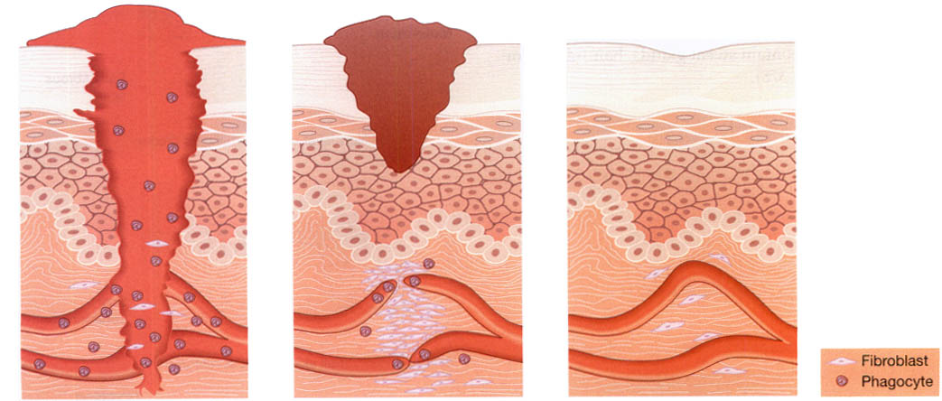
Wound Healing, Repair and Regeneration of Tissue
Primary union (healing by first intention)
Inflammation
Proliferation
Maturation
Fig: Stages in primary wound healing.

Slide 181
Wound Healing, Repair and Regeneration of Tissue
Secondary union (healing by secondary intention)
Definition: occurs in wounds that have large tissue defects and when the two skin edges are not in contact.
It requires larger amounts of granulation tissue to fill in the defect.
Often accompanied by significant wound contraction.
Often results in larger residual scars

Slide 182
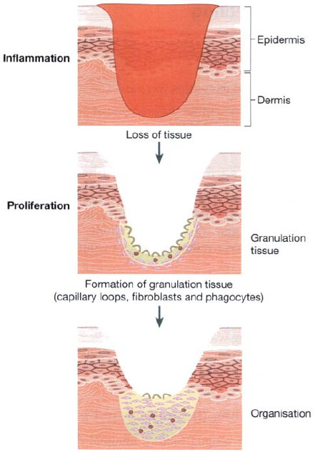
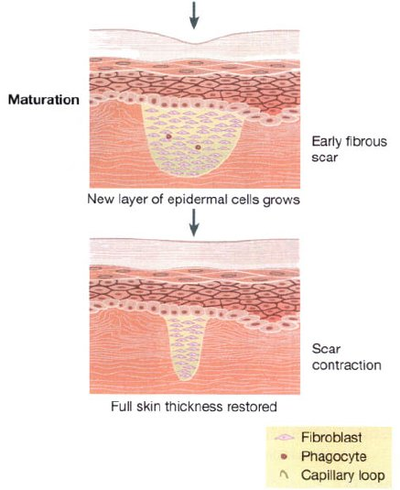
Wound Healing, Repair and Regeneration of Tissue
Fig: Stages in secondary wound healing.

Slide 183
Thank You…!!!
End of Unit I

